Slide 1

Cancer-associated Thrombosis for Oncology Clinicians
Adrian Yee, MD, FRCPC, MET
Hematologist, Victoria BC

Slide 2

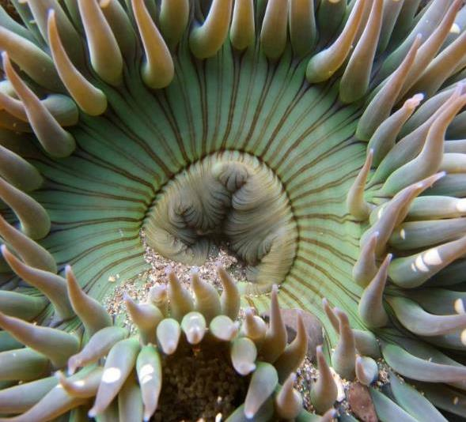
Learning Objectives
Identify risk factors and mitigate the risks.
Develop a management approach.
Develop an individualized management plan for patients in rural and remote regions.

Slide 3
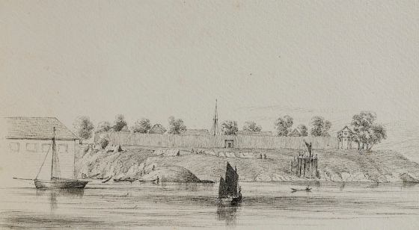
Territorial Acknowledgement

Slide 4
Conflict of Interest
I declare no conflict of interest relevant to this presentation.

Slide 5
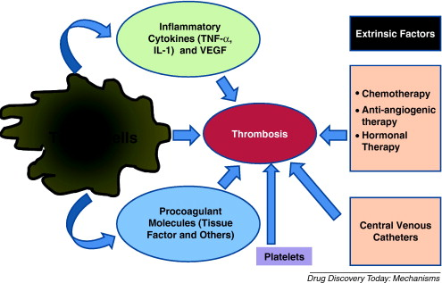
Cancer Associated Thrombosis
Common complications in patients with cancer; estimate ranging from 1% to 30%.
Negatively affect mortality among cancer patients.
Second leading cause of death in cancer patients.
Hematology Am Soc Hematol Educ Program (2010) 2010 (1): 144–149.

Slide 6
Risk Factors for VTE in Cancer
Risk varies from 1 – 30% depending on:
Patient-related
Older age
Prior VTE
Platelet count
Comorbid conditions
Cancer-related
Primary site
Histology
Metastatic disease
Time interval since diagnosis
Treatment-related
Surgery
Chemotherapy
Hormonal therapy
Antiangiogenic therapy
ESA
Hospitalization
Catheters
Lyman et al. J Clin Oncol 2007.

Slide 7
Case 1
A 47-year-old patient has a history of increasing abdominal bloating. CT was consistent with an adnexal mass. She has been referred to Gyne-Oncology for surgery due to the concern of ovarian/fallopian tube cancer.

Slide 8
Venous Thromboembolism Risk
Cancer-related
Risk Factors
Treatment-related
Risk Factors
Risk of VTE
Patient-related
Risk Factors
Courtesy of Dr. Agnes Lee
8
Notes:
8
8

Slide 9
VTE Risk Factors
Patients/Context
Cancer-Related
Metastatic disease
Extreme Risk: Stomach, Pancreatic
High Risk: Lung, Lymphoma, Myeloma, Gynecologic, GU excluding prostate
Systemic Therapy: Bevacizumab, Lenalidomide, Gemcitabine, Cisplatin, Tamoxifen
Previous history of VTE
Obesity
Post-operative (more than 45 minutes of General Anesthesia)
Thrombophilia
Abdominal surgery/Joint surgery
Spinal Cord injury

Slide 10
DVT Prophylaxis
Prolonged immobilization
Post-abdominal surgery for cancer
Ambulatory Patients with Cancer​
DVT prophylaxis until mobilized well.
Dalteparin 5000 units once a day for 10 days for abdominal or pelvic cancer surgery.
For patients with previous VTE history, anesthesia lasting longer than 2 hours and/or bed rest lasting 4 days or longer following surgery: up to 28 days.
Routine prophylaxis is NOT recommended

Slide 11
Case 2
A 78-year-old patient has stage 4A Follicular lymphoma grade 2 and completed 6 cycles of Bendamustine and Rituximab. Post-chemotherapy CT shows subsegmental Pulmonary Embolism. No recent surgery or any bleeding history.
The patient does not have any symptoms. No chest pain, dyspnea or palpitations. No lower extremity symptoms.
Recent CBC differential: Hemoglobin 120, WBC 3.1. Neutrophil 1.3, Platelet 170, LFT are normal. GFR 70.

Slide 12
Anticoagulation or Surveillance: that is the question
Incidental PE is a frequent finding (3.6% of oncological CT Scans).
Optimal management has not been addressed in clinical trials.
The embolic load is lower than in symptomatic PE.
The consensus is to anticoagulate unless it is contraindicated
Optimal Management
Cancer-associated incidental PE | At least 6 months and beyond for the duration of active disease
Frederikus A. Klok, Menno V. Huisman
European Respiratory Journal Jun 2017, 49 (6) 1700275;

Slide 13
Case 2: Selection of Anticoagulant
69-years-old patients with metastatic colon cancer and on Capecitabine. He has type 2 diabetes and hypertension
He has worsening shortness of breath and pleuritic chest pain
On examination, he is stable. Chest examination is normal. Cardiac examination is normal
Had an urgent Spiral CT – bilateral Pulmonary Embolism.

Slide 14
In-Patient versus Outpatient
Stratify Patients into High risk versus Low risk
Using PESI score: Pulmonary Embolism Severity Index (PESI) – MDCalc
Age over 65, Male, History of Cancer, Heart Failure, Chronic Lung Disease, HR over 110, Systolic BP less than 100, RR over 30, Temperature under 36C, altered mental status
Social and Contextual situation should be taken into account
Very low or low risk: recommend outpatient treatment
Outpatient treatment of pulmonary embolism | European Respiratory Society (ersjournals.com)

Slide 15
Which Anticoagulant?
Dalteparin/Enoxaparin
DOAC
Supported by multiple RCTs (CLOT trial)
Reduce risk of recurrence by 17% compared to Warfarin
Daily injection.
Cost: $20 to $50 per day
Covered by Pharmacare
Supported by Multiple RCTs
Equivalent to LWMH
Cost is lower
Covered by Pharmacare
High risk of bleeding for patients with luminal disease or had recent surgery.

Slide 16
What about Warfarin?
In exceptional contexts:
Chronic kidney disease (GFR under 25).
Controversial: patient’s weight is over 120 kg.
Patient’s desire.
Careful titration during chemotherapy.

Slide 17
Duration of Therapy
Chronic Malignancy
Curative Malignancy
Continue until 3 months after the last cycle of chemotherapy
Counsel patient on the risk and symptoms of VTE recurrence
During high-risk period such as prolonged immobilization/surgery, we recommend DVT prophylaxis
Long term anticoagulation unless patients develop bleeding or are at high risk of bleeding
Continue until the transition to symptomatic care alone

Slide 18
Case 2: Tackling Drug Interaction
75-years-old patient with metastatic prostate cancer and is on Apalutamide.
He now has swelling and pain in the left leg.
Ultrasound Doppler shows left proximal DVT
Blood counts hemoglobin 110, WBC 2.5, Neutrophils 1.8 and Platelet 150. Creatinine 70.
What is your plan?

Slide 19
Apalutamide
Strong inducer of CYP3A4 and CYP2C19 and a weak inducer of CYP2C9 and P-glycoprotein.
For dual-inducer of CYP3A4 and P-glycoprotein increase effect of Apixaban and Rivaroxaban.
P-glycoprotein inducers can reduce the effects of Dabigatran and Edoxaban.
Safest: low molecular weight heparin
Second choice: Edoxaban

Slide 20
Checking Drug Interaction
Cautions:
Digital Resources
Getting advice
HAART
Clarithromycin
Dilantin
DOACs PK and drug interactions - UpToDate
BCCA Pharmacists
Community/Hospital Pharmacists

Slide 21
Case 3: Management of break-through clot.
78-years-old patient with advanced stage Pancreatic cancer. He had right proximal DVT 1 month ago and started on Apixaban 10 mg bid for 7 days and transitioned to Apixaban 5 mg bid.
He now has worsening swelling of right leg. Repeat ultrasound Doppler – progression of DVT.
What is your plan?

Slide 22
Break-Through Clot
Check adherence to the regiment.
Switch to LMWH for 3 months and reassess after.
Inferior Vena Cava filter is NOT indicated for the management of breakthrough clots.
If patients progress while on a therapeutic dose of LWMH, you can increase the dose by 20%.
Unfortunately, 20% of patients with pancreatic cancer die from venous thromboembolism.

Slide 23
IVC Filter – if not now, then when?
Principle: Careful consideration and discussion of risks and benefits with patients
Risks:
Immediate complication during placement: bleeding, misplacement and embolization
Migration
Infection
IVC Thrombosis and fibrosis distal to the IVC filter
Thrombosis Canada Guidelines 2020

Slide 24
IVC Filter: Caution
Only indicated in patients with a recently diagnosed VTE (within 4 weeks) acute proximal DVT or acute PE in whom there is a contraindication to anticoagulation (active bleeding or perioperative)
Patients should have the filter removed once appropriate anticoagulation is started.

Slide 25

Case 4: Rural and Remote Context
A 69-year-old patient with metastatic breast cancer and is on chemotherapy. She resides in a Northern community.
She presents with swelling of the left leg for 48 hours. No respiratory symptom. No Chest pain.
It will take 9-hours to drive to Prince George for an ultrasound Doppler or transfer to Vancouver General Hospital by flight.

Slide 26
What are your suggestions?

Slide 27
No Perfect Answers
Organize a d-dimer test:
  Caveats: Not validated for patients with active malignancy and long turnaround time.
Arrange POCUS: operator dependent, availability.
  By application of Well’s criteria and D-Dimer as indicated, POCUS has a sensitivity of 93% and a specificity of 90%
Anticoagulated empirically: discuss risk and benefits
Varrias, D., Palaiodimos, L., Balasubramanian, P., Barrera, C. A., Nauka, P., Melainis, A. A., Zamora, C., Zavras, P., Napolitano, M., Gulani, P., Ntaios, G., Faillace, R. T., & Galen, B. (2021). The Use of Point-of-Care Ultrasound (POCUS) in the Diagnosis of Deep Vein Thrombosis. Journal of clinical medicine, 10(17), 3903. https://doi.org/10.3390/jcm10173903

Slide 28
Peri-Operative Anticoagulation
65-year-old patients with colon cancer and completed chemotherapy in 2015. He has a history of DVT in 2019 and is on Rivaroxaban 20 mg once daily.
He has a 3-cm mass in the retroperitoneal area and will need a CT-guided biopsy.
What is your plan?

Slide 29
Anticoagulation Interruption
Factors to consider
Resources
Renal function
Risk of procedure
Risk of VTE recurrence
Compressible versus non-compressible sites
For patients with prosthetic heart valves, recent VTE (less than 3 months), atrial fibrillation with prior stroke, do NOT stop anticoagulation without consultation with GIM or Hematology.
Management Guidelines LM v10.2 2015-03 (fraserhealth.ca)

Slide 30

For Retroperitoneal Biopsy
High Risk of Bleeding
What if VTE occurred less than 4 weeks ago?
Can we defer the procedure until at least 1 to 2 months after the VTE?
If the procedure is emergent, consult Hematology.
Depending on circumstances, we will request a temporary IVC filter and/or bridging anticoagulation on Day -1, Day +1 and Day +2 before restarting on Rivaroxaban.
Stop Rivaroxaban 3 days before the procedure.
Resume the first dose 3 days after the procedure.

Slide 31
Summary
Cancer-associated thrombosis is a common complication.
DVT prophylaxis is indicated in the postoperative setting or hospitalized patients.
Long-term anticoagulation is recommended for patients with chronic malignancy.
Avoid using an IVC filter.
Follow guidelines on the perioperative procedure.

Slide 32



If you need advice:

Slide 33

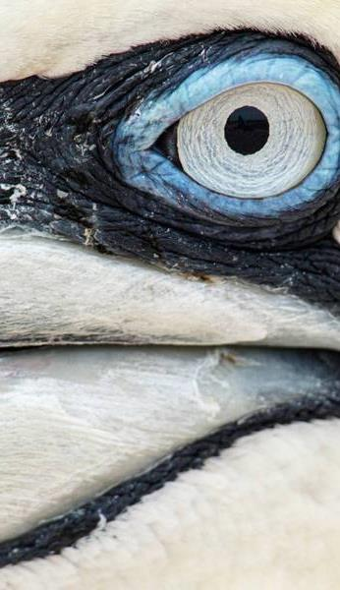
Thank you!
adrian.yee@ubc.ca

