Slide 1
An Introduction to Systemic Therapy
Notes:
Hello everyone, welcome to “An Introduction to Chemotherapy and Other Drug Therapies” A Presentation for Patients and Families.
My name is _______________ . I am a Registered Nurse/Pharmacist/Other at _____________________.
Introduce other members of the team/volunteers (as required)
There are 6 regional cancer centers across British Columbia. It is important for you to know that no matter where a person lives in BC, if they have a diagnosis of cancer they will receive the same treatment anywhere in the province.

Slide 2
Welcome and Introduction
Review
General and specific side effects
How to manage side effects
What symptoms to report
How to report symptoms
Questions
Tour of Regional Centre
Notes:
Just a few reminders:
If you can’t hear me or if you need clarification at any point - please raise your hand.
Please turn cell phone off, or put it on “silence”
We would like to keep this session informal, so feel free to ask questions at any point.
There will also be time at the end for questions.
If you do not already have your Treatment Information Booklet “Chemotherapy and Other Drug Therapies”– please let us know now. (circulate booklets)
Read from the slide……

Slide 3
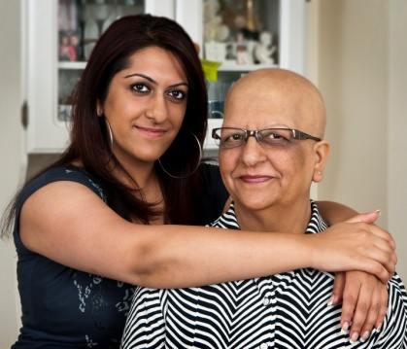
Health Care Team
Person living with cancer
Physicians:
Oncologist,
Family Doctor
Patient & Family Counsellors
Nurses
Pharmacists
Dietitians
Unit Clerks
Secretaries
Volunteers
Speech –Language Pathologists
Notes:
There will be a team of healthcare providers available to you throughout your treatment and into your follow-up care phase. Each care provider has their own unique role to play in supporting you during this time. Some of your team members will work directly with you to provide your treatment and address any care needs you may have. Other members are available to support you and your family with any physical and/or emotional impacts of a cancer diagnosis and treatment.
During your cancer treatments – it is very important to stay closely connected to your family doctor – so they can monitor your non-cancer health Your Health Care Team includes:
YOU
Oncologists
Family doctor/GP
Registered Nurses
Pharmacists
Patient & Family Counselors
Dietitians
Volunteers
Also note Librarians (available for your informational needs)
3

Slide 4
What is Cancer?
Disease that starts in our cells
Our body’s cells normally grow in an orderly fashion
Cancer cells do NOT behave like “normal cells”
grow to form lumps or tumours
may spread to other parts of the body
Cancer is named after the part of the body where it started
Notes:
4
What is cancer?
Cancer is a disease that starts in the cells.
Our bodies are made up of millions of cells, grouped together to form tissues (such as muscles, nerves and bones) and organs (such as the lungs and the liver).
Cell in the body normally grow, reproduce and die.
But sometimes the information gets mixed up, causing the cells to behave and grow abnormally. These abnormal cells can then develop into tumours which can spread to other parts of the body.
Different types of cancers vary in their signs and symptoms, how fast they grow, and how they respond to different treatments.

Slide 5
Cancer Treatment
Surgery
Radiation Therapy
Systemic Therapy
Smoking cessation
Treatments for cancer are:
Surgery
Radiation therapy
Systemic therapy
Smoking Cessation
Smoking Cessation is a part of cancer treatment
If you use recreational tobacco: Stop smoking
Stopping smoking at the time of cancer diagnosis could lower the risk of death by up to 40%
Smoking cessation is cancer treatment
Notes:
Treatments for cancer include surgery, radiation therapy, systemic therapy and smoking cessation.
Smoking cessation is a part of cancer treatment, so if you use recreational tobacco we recommend stopping smoking. This does not include ceremonial tobacco used by indigenous groups.
The 50th anniversary of the Surgeon General's report on smoking reported that stopping smoking at the time of cancer diagnosis could lower the risk of death by up to 40%
For some patients the benefits of quitting smoking being equal to, or even exceeding, the value of the latest cancer therapies

Slide 6
Stopping Smoking
Helps your treatment work better to fight the cancer
Lowers your chance of having a complication or bad reaction to treatment
Can help your wounds heal faster, less chance of infection
Lowers treatment toxicity/severity of your side effects
Improves your prognosis
Notes:
In addition, smoking is associated with increased infection rates, lung complications, impaired wound healing following surgery for cancer and longer hospital stays.
Stopping smoking can help your other cancer treatments work better, lower your chance of complications and side effects, and for side effects you do experience they may be less severe.
Overall, quitting smoking will improve your quality of life…helping you to live better

Slide 7
Smoking Cessation Support
Free nicotine replacement (NRT) is available from any pharmacy
Quitnow.ca, gives customized programs:
smoking cessation counselling
quit plans
VGH smoking cessation clinic:
Appointments with staff trained in tobacco dependence treatment
First Nations Health Authority
Tobacco Timeout Challenge
Factsheet & resources for NRT through First Nations Health benefits
BC Cancer nursing support - We are here to help!
Notes:
There are lots of resources available to support you in stopping smoking including:
Free nicotine replacement therapies like the patch or gum which you can get from any pharmacy without a prescription. Just talk to your pharmacist!
QuitNow is a provincial phone line that provide you direct support in making a quit plan and seeing it through
If you live in the lower mainland you ask for an appointment at the Vancouver General Hospital smoking cessation clinic
The First Nations Health Authority has resources and supports for patients with indigenous heritage\
And of course any Oncology Nurse at BC cancer can further discuss benefits of quitting smoking and tobacco use and refer you to the Quitnow program

Slide 8
What is Systemic Therapy?
Chemotherapy
Drugs that destroy cancer cells
Immunotherapy
Drugs that activate your own immune system to find and destroy cancer cells
Hormone Therapy
Drugs that change levels of hormones to stop or slow down cancer cell growth.
Targeted Therapy
Drugs that target specific molecules that stop cancer cells from growing and spreading
Notes:
8
Systemic therapy means treatment of cancer using drugs.
These include chemotherapy, immunotherapy, targeted or hormone therapy
There are many different drugs used to treat cancer. They work in different ways and are sometimes called different names.
Systemic Therapy – means a drug therapy which travels throughout the body via the blood stream – and can affect both cancer cells and normal cells. You may have heard some of these words already to describe your treatment.
Chemotherapy- drugs that destroy cells (normal and cancer cells). Also known as “chemo.”
There are over 100 different types of drugs. Sometimes the are called cytotoxic because they kill cells.
Hormone Therapy- Drugs that change levels of hormones to stop or slow down cancer cell growth.
Immunotherapy- drugs that activate your own immune system to find and destroy cancer cells.
Targeted Therapy- drugs that target specific molecules that stop cancer cells from growing and spreading.
All of these are systemic therapies.
*Consider asking the audience if they have heard some of these names before.
Reference: Canadian Cancer Society 2016 “Chemotherapy and Other Drug Therapies”

Slide 9
Goals of Systemic Therapy Treatment
Eliminate the cancer
Shrink the tumour
Prevent cancer from spreading
Relieve symptoms from cancer, such as pain
Notes:
9
Goals of Systemic Therapy Treatment are:
READ the SLIDE

Slide 10
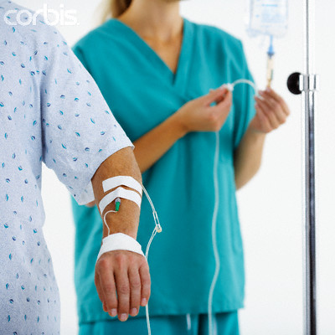
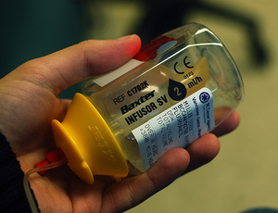
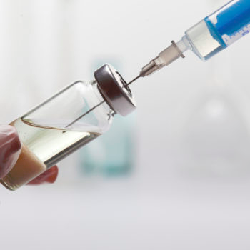
Systemic Therapy is given by…
Intravenous
Pills
Infusion Pump
Injection
Notes:
10
Drugs can be administered either by intravenous, pill, injection or through an IV infusion pump.
If you are to receive your therapy using the intravenous or injection methods you will be given an appointment date and the time will be confirmed closer to that date.
A Registered Nurse will administer your treatment and review your treatment plan and potential side effects.
Treatments can take several minutes - to several hours - up to a full day depending on the protocol.
Some patients go home with a continuous chemotherapy IV infusion pump.
If your therapy is to be given in the form of pills – you will be provided with an appointment to meet with the pharmacist who will give you your prescription, review the side effects of your treatment; and reinforce who and when to call for medical advice.

Slide 11
Side Effects from Systemic Therapy
There are potential side effects for each specific treatment
You will NOT experience ALL side effects
Some side effects can be managed
Notes:
11
There is a long list of possible side effects. No one experiences all of these side effects. Not all drugs cause these side effects.
This information is not meant to scare you – but to prepare you if you do experience side effects.
Your treatment nurse or pharmacist will discuss the specific side effects related to your particular drugs
We know some side effects can be prevented
For example, we know some drugs can cause nausea and vomiting. So we prescribe anti-nausea drugs to prevent nausea and vomiting from happening.

Slide 12
Potential Side Effects
Bone marrow suppression
Nausea and vomiting
Blood clots
Diarrhea
Constipation
Hair loss
Fatigue
Mouth sores
Skin changes
Reproductive / hormonal changes
Sensory changes
Thinking, memory and attention changes
Notes:
12
We will be discussing the most common side effects of systemic therapy (chemotherapy, immunotherapy or targeted therapy)- your treatment nurse or pharmacist will review the particular side effects related to your specific treatment upon your first appointment.
There is more detailed written information in YOUR PACKAGE and your treatment nurse will review this at your 1st appointment.
If you experience any of these side effects – please contact your health care provider using the contact list provided to you. For some side effects, you might find it helpful to write them down during your treatment and bring them to your next appointment to discuss with your doctor or nurse.

Slide 13
Patient resource
“Chemotherapy and Other Drug Therapies:
A guide for
people with cancer”
Notes:
This booklet offers information about treatment, tips on managing side effects and s. Supportive care. (Make sure everyone has a booklet)

Slide 14
Bone Marrow Suppression
Blood cells of the bone marrow:
Red blood cells – carry oxygen to body’s cells
White blood cells – fight infection
Platelets – form blood clots/scabs
Blood cell levels may decrease following chemotherapy
Expected to return to normal by the start of next treatment
Notes:
You may hear your nurse, doctor or pharmacist discussing your “blood counts". They are referring to the different blood cells in your blood stream - including your white blood cells, red blood cells and platelets.
Each blood cell has a different function in the body
Read from the slide
These blood cells may decrease in number following chemotherapy – but they are expected to return to normal before the next treatment.

Slide 15
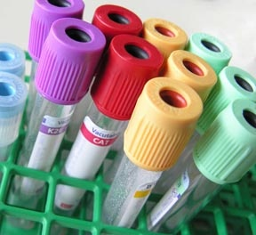
Checking Blood Cells
Blood cells must return to a “safe” level before each treatment
Blood tests are done 1 to 4 days before treatment
**Check appointment card and lab requisition**
Blood test results may affect treatment
Notes:
Prior to each treatment ( and sometimes in the middle of your treatment cycle) you will have a blood test to check the level your blood cells.
The results of blood tests will determine whether your blood cells have recovered enough; and whether it is safe to proceed with your treatment
If your blood cells are not fully recovered, your Oncologist may still proceed with treatment – however they may reduce your dose.
It is not unusual for your treatment to be delay up to a week if your blood cells are too low.

Slide 16
Low White Blood Cells (Neutropenia)
White cells are your infection fighting cells
May be lowered for a short time after your cancer treatment
Your body will be less able to fight infection
It is important to recognize the signs and symptoms of an infection
What are some signs of infection?
Notes:
16
There are several types of white blood cells in our circulation, but the main cells that fight infection are called the NEUTROPHILS
White blood cells are affected by some cancer drugs and may be decreased following your treatment. This is called NEUTROPENIA. Your neutrophils will begin recovering prior to your next treatment.
When the neutrophil count is low, your body is less able to fight an infection on its own - so you will need to watch for signs of infection.
If you develop any signs or symptoms you need to call the cancer center immediately.
What are the signs and symptoms to watch for?

Slide 17
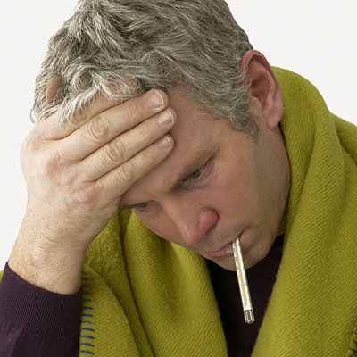
Signs and Symptoms of Infection
FEVER
Flu-like symptoms, e.g. body aches
Feeling warm, chilled or shaky
Sore throat and/or mouth
Cough and/or shortness of breath
Burning when urinating/urinating more often
Areas of redness or tenderness
Loose or liquid stools
Severe dizziness
*REPORT all Signs and Symptoms*
Notes:
17
READ SLIDE : LIST THE SIGNS AND SYMPTOMS
If you have any of these signs of infection then check your temperature.

Slide 18
If your temperature is 38°C or more (or 100.4°F or more)…
This is a FEVER
Fever is a sign of infection, even if you don’t have any other signs
Fever is serious when your white blood cells are low
Do not take drugs for fever (e.g. Tylenol®) unless directed by your cancer care team
Report a FEVER IMMEDIATELY!
Numbers to call are in your package
Notes:
Temperature of 38 or higher is a serious medical emergency. Day or night – you must report a fever immediately.
Refer to center specific process and numbers.
This information will be reviewed again at your first treatment appt.
18

Slide 19
How you can prevent infection
Wash your hands - frequently with soap and water
Avoid people with infections
Wash your hands
Check with your oncologist before having any invasive procedures (e.g. dental or surgical procedure)
Avoid skin cuts and nicks
Wash your hands
Notes:
19
The best way to prevent infections is to WASH YOUR HANDS
Wash your hands before eating and preparing food, and after using the bathroom, sneezing etc.
Wash all fresh fruits and vegetables thoroughly
You can use a waterless cleaner if you do not have access to soap and water.
When others in your household are sick - have them wash their hands more often to prevent the transmission of germs
Once you learn which days your blood cells may be low…then you may want to be more careful, avoid people with obvious colds; stay away from large crowds in confined areas.
Avoid children who have the chicken pox or measles or adults who have shingles.
Flu vaccine – is recommended during flu season. Please talk with your oncologist before getting a vaccination.
Good oral care is essential - brush your teeth with a soft toothbrush after eating and before bedtime.
Consult your nurse Prior to a dental appointment –.
Avoid handling pet feces - including fish tanks
Avoid skin cuts
Water-soluble lubricant and a condom should be used during intercourse.

Slide 20
Do I come to the clinic if I have an infection?
Call the Cancer Centre FIRST!
If you have an infection (flu) or
If you have been exposed to an infectious illness such as chicken pox or shingles
Friends and family with infections should stay at home until they have recovered
Notes:
20
Patients must call ahead prior to coming to clinic if you have
a cold / flu / rash
READ SLIDE
If you are unsure, please call one of the clinic nurses to check that it is safe to come to clinic.

Slide 21
Low Platelets (Thrombocytopenia)
Platelet cells are responsible for making clots
May be lowered for a short time after your systemic therapy treatment
Your ability to form a clot will be lowered
It is important to recognize the signs and symptoms of low platelets
What are some signs of low platelets?
Notes:
READ off slide

Slide 22
Signs and Symptoms of Low Platelets
Cut that won’t stop bleeding
Bruises on body
Bleeding from nose and gums
Red pinpoint rash
Black tarry stools
Blood in urine
*Report any signs and symptoms*
Notes:
READ off slide

Slide 23
How to Manage Low Platelets
Use soft tooth brush
Continue regular oral hygiene, caution with flossing
Blow nose gently
Avoid ibuprofen(Advil) & aspirin(ASA), unless ordered by Doctor
Avoid high risk activities - BE CAREFUL
Notes:
READ off slide - high risk activities…..fileting a salmon / mountain biking

Slide 24
Low Red Blood Cells (Anemia)
Red cells are responsible for carrying oxygen to the body’s cells
May be lowered for a short time after your systemic therapy treatment
Your energy level will be affected
It is important to recognize the signs and symptoms of low red cells
What are some signs of low red cells?
Notes:
READ off slide

Slide 25
Signs and Symptoms of Low Red Blood Cells
Low energy / fatigue
Shortness of breath
Pale appearance
Chest tightness / chest pain
*Go to the nearest emergency if you have chest tightness or chest pain*
*Report any signs and symptoms*
Notes:
READ off slide
Emphasize Chest tightness/chest pain as an emergency.

Slide 26
Fatigue
Fatigue is the most common symptom during and after cancer treatments
Signs and symptoms
Feeling of weariness, tiredness, or lack of energy that does NOT always improve with rest
May affect your ability to do daily activities
Often overlooked, but it is real and can be managed
Notes:
26
Fatigue is a feeling of weariness, tiredness, or lack of energy that does NOT improve with rest.
Fatigue is one of the most common symptoms during treatment.
It usually occurs in the first week after treatment
As the number of treatment cycles increases, fatigue may get worse or last longer
The fatigue experienced by a person with cancer is different from fatigue of everyday life.
Cancer treatment-related fatigue can appear suddenly, and be overwhelming. It is not always relieved by rest. It can last after treatment ends.
It may affect an individual's mood or emotions. It may also affect a person's ability to do usual activities and can make it hard to concentrate.
Talk to the Registered Nurse about what can be done to preserve quality in your life.

Slide 27
How to Manage Fatigue
Do regular light exercise
Balance physical and social activities with rest
Listen to your body and rest when needed
Stick to a regular sleep pattern
Eat a well balanced diet
Drink plenty of fluids
Allow friends and family to help you
Resource: Your Bank to Energy Savings “Helping People with Cancer Handle Fatigue”
Notes:
27
READ off slide
Inform your Registered Nurse or oncologist if you are having difficulty managing fatigue.

Slide 28
Blood clots
A blood clot is a clump of blood that is semisolid. Patients with cancer on systemic therapy are at risk for blood clots.
Signs and Symptoms
Sudden severe shortness of breath
Swelling of one leg
Painful blue fingers/toes
Heart attack or stroke (very uncommon)
Sudden confusion, trouble speaking, trouble seeing
Sudden numbness or weakness in face, arm or leg
Chest tightness or chest pain.
*If you experience any of these symptoms, go to the nearest emergency room*
Notes:
READ off slide
Emphasize: Changes in vision/strength on one side of body is a medical emergency.

Slide 29
Nausea and Vomiting
Nausea = an unpleasant, queasy feeling or feeling sick to your stomach
Vomiting = throwing up
Not all people will experience nausea and vomiting
Notes:
29
READ off slide

Slide 30
Medications to Prevent Nausea and Vomiting
Doctor will give you a prescription to help prevent nausea and vomiting
Fill your prescriptions at your community pharmacy
Bring the medications with you
Unless advised, do not take these pills prior to coming to your appointment.
If cost is a concern:
Patient & Family Counselling Services can provide information and referrals
Notes:
Your physician will prescribe anti-nausea drug to help prevent nausea and vomiting. This prescription needs to be filled at your community pharmacy – we ask you bring the pills with you for your first appt.
These prescription can be costly - let your doctor or Registered Nurse know if you need help financially.
If you need more information or assistance, contact the Patient and Family Counselling Services.

Slide 31
How to Manage Nausea and Vomiting
Stay well hydrated - 8 cups of fluid
Eat frequent, small, light meals (esp. on treatment day)
Keep your mouth clean: brush at least twice daily
Avoid:
Hot, spicy, greasy foods
Heavy meals right after treatment
Strong smells
Resource: “Practical Tips to Help Manage Nausea”
Notes:
31
READ off slide

Slide 32
Constipation
When you are not having bowel movements as often as you used to.
Caused by:
Some cancer drugs
Some anti-nausea drugs
Most pain medications
Reduced fluid or fiber intake
Stress
Lack of exercise
Resource: “Food Choices to Help Manage Constipation”
Notes:
READ off slide

Slide 33
How to Manage Constipation
It is normal to have a bowel movement at least every 2-3 days (even when little food is eaten)
How to prevent:
Increase your fluid intake – 8 glasses/day
Warm fluids
Increase your fiber intake
Be as physically active as possible
If you have not had a bowel movement in 3 days please talk to your cancer care team
Notes:
READ off slide

Slide 34
Diarrhea
When your bowel movements are more frequent or more watery than normal
Can be serious if not managed
Some causes:
Cancer therapy drugs
Antibiotics
Bowel surgery
Radiation to the pelvis
Notes:
READ off slide.
Maybe associated with urgency, cramping and bloating

Slide 35
How to Manage Diarrhea
Eat small/frequent meals
Choose foods with less fiber
If prescribed by your oncologist – use your anti-diarrhea drugs as instructed.
Avoid:
Foods that may aggravate diarrhea
Spicy/greasy foods
Resources: “Food Choices to Help Manage Diarrhea” and “Low Fibre Food Choices”
Notes:
There are many reasons why you might experience diarrhea. It could be related to the drugs you are receiving. There are different ways to manage diarrhea, and are based on which systemic therapy drugs you receive.
Some of you may have been prescribed anti-diarrhea drugs by your doctor to treat diarrhea– you may take them as you have been instructed to do so. Other people will need a very different treatment for their diarrhea as it has the potential to be more serious.
When you have your first treatment – the nurse who teaches you about side effects related to your specific drugs – will review exactly how to manage diarrhea and when to report this to the healthcare provider.

Slide 36
Dehydration
Dehydration can be a result of untreated diarrhea
Can be dangerous if not prevented/managed
How to prevent/manage:
Drink 8 to 10 glasses of fluid
Use “anti-diarrhea” drugs - as instructed by your health care team
When you feel better, eat foods high in calories and protein
Diarrhea lasting more than 24 hours - contact your cancer care team
Notes:
READ off slide

Slide 37
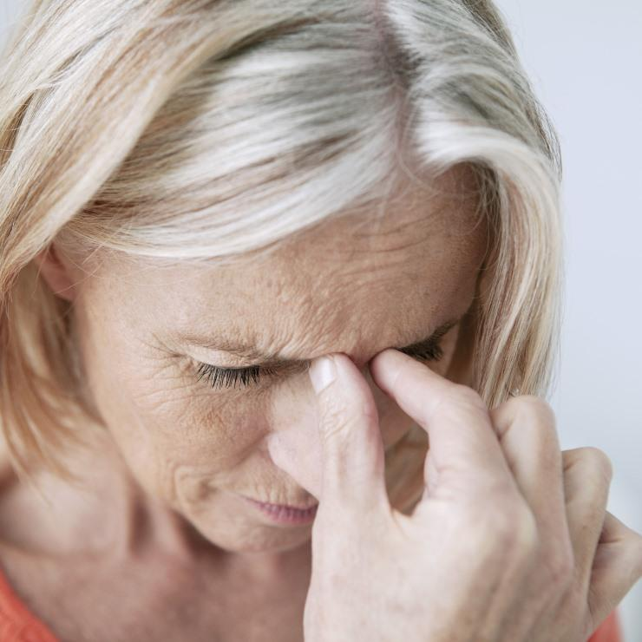
Signs and Symptoms of Dehydration
Fatigue
Extreme thirst
Nausea
Dry mouth
Low urine output
Dark colored urine
*Report any signs and symptoms*
Notes:
READ off slide

Slide 38
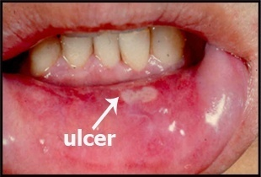
Mouth Sores
Occur within a few days after treatment
On the tongue, gums, sides of the mouth, lips and throat
Signs and symptoms:
Pain
Bleeding gums
Difficulty chewing and swallowing
Can lead to an infection
*Report any signs and symptoms*
Notes:
38
Treatments can cause mouth sores that may occur a few days after treatment.
Mouth sores can occur on the tongue, gums, the sides of the mouth, lips, and in the throat.
Mouth sores or bleeding gums can lead to an infection, and difficulty eating and swallowing

Slide 39
How to Manage Mouth Sores
Look in your mouth regularly
Practice good oral hygiene
Rinse 3 to 4 times a day - baking soda in warm water
Use a soft toothbrush
Avoid mouthwash with alcohol
Make sure dentures fit well
Avoid irritating foods and liquids (acidic, spicy, salty, dry, alcohol-based, rough, extreme hot or cold)
Resource: “Food Ideas to Try with a Sore Mouth”
Notes:
39
READ off slide

Slide 40
Skin Changes
Skin is body’s first line of defense against bacteria
Signs and symptoms:
Redness
Rash / acne
Itching
Peeling
Dryness
Notes:
READ off slide

Slide 41
How to Manage Skin Changes
Wash skin often
Warm water and gentle soap
Moisturizers – alcohol/fragrance free
Lanolin based lip balms and creams
Protect against sun exposure (clothing or SPF 30)
Wear protective eye wear and hats
Use electric razor
Notes:
READ off slide
When you have your first treatment – the nurse who teaches you about side effects related to your specific drugs – will review exactly how to manage skin changes and when to report this to the healthcare provider.

Slide 42
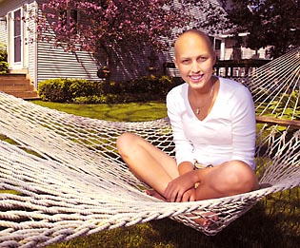
Hair Loss
Some drugs may cause your hair
to fall out or to change colour.
Hair loss starts about 2-3 weeks after 1st treatment
Scalp could feel tender when hair starts to fall out
Some people prefer to cut their hair short
We suggest not cutting your hair until you come to your 1st treatment appointment
Your hair will begin to grow back 3-4 weeks after final treatment
Notes:
42
Hair loss is a side effect of systemic therapy, but not all drugs cause hair loss. Some but not all may cause your hair colour to change.
Hair loss is temporary
When your hair does begin to grow back, it may be a different texture or colour

Slide 43
Resources for Hair Loss
“Prescription” for a wig from the oncologist
Visit a wig shop before you lose your hair
Donated wigs at Canadian Cancer Society
Look Good Feel Better Program – call local Canadian Cancer Society office to register.
Resources:
Information can be found on the BC Cancer Website (Coping with Cancer), Volunteer Services and Patient & Family Counselling Services
Notes:
Prior to losing your hair, you may want to visit a wig shop to match your hair colour
Gently-used donated wigs are available through the Canadian Cancer Society please call for nearest location

Slide 44
Sensory Changes
Senses potentially affected by treatment:
Touch – Muscles and Nerves
Sound – Hearing
Taste
Smell
Sight
Notes:
READ off slide

Slide 45
Taste Changes
Foods may not taste the same
Described as “metallic” or “cardboard” taste
Can affect your appetite
Use of sweet and salty flavorings - can help
Changes are temporary
Resource: “Food Ideas to Cope with Taste and Smell Changes”
Notes:
READ off slide

Slide 46
Memory Changes
Some memory changes
Concentration
“chemo-brain” or “brain fog”
Difficulty thinking and focusing
May be caused by treatment, fatigue, stress, insomnia
How to manage memory changes:
Plan activities
Make lists
Ask for help: Patient & Family Counselling
Resource: Coping with Cancer pages on BC Cancer Website
Notes:
46
Changes in your memory and concentration can be very subtle or they can be quite bothersome.
These side effects may disappear after your treatment is completed.
If you are concerned about these changes – please contact Patient and Family Counselling to speak with a counselor

Slide 47
Reproductive and Hormonal Changes
Treatment may cause changes in hormone levels or reproductive organs:
may affect your fertility
may cause early menopause
may change your sexual desire
Talk to your cancer care team for more information
Talk to Patient & Family Counselling Services for support
Resource: “Sexuality and Cancer”
Notes:
47
Information below can be used to help answer questions:
Some treatments may cause changes to hormonal system; men may decrease the sperm count
For some men, sperm banking may be appropriate prior to starting treatment. If unsure, speak with your doctor
Birth control is very important for BOTH men and women. Pregnancy MUST be avoided while on treatment
If you need guidance with concerns about intimacy and your relationships, contact Patient and Family Counselling Services

Slide 48
Tips for Treatment Day
Length of treatments can vary
Wear comfortable clothing (sleeves that roll up)
No perfume / fragrance for patients or support people: due to sensitivities to smell
Eat a light meal before and after treatment
Take your regular medications
Transportation:
Arrange a ride to and from your appointment
Parking:
BC Cancer - please bring money for the parking meter
Notes:
48
READ off Slide
Each cancer centre can talk about cafeterias etc.

Slide 49
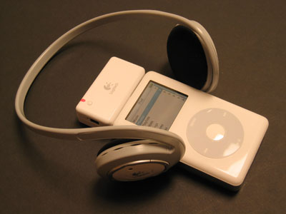
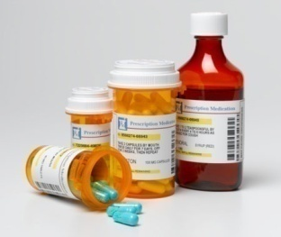
More Tips
Bring:
Snacks & drinks (no strong smells)
Support person - 1 support person at a time (children are not allowed in treatment areas)
Magazines, books, music with headphones
New Patient Package
Questions
Anti-nausea pills
Prescriptions:
Approved cancer treatment drugs are filled by the BC Cancer Pharmacy
Your anti-nausea prescriptions are filled in your community pharmacy
Notes:
Read off slide-
Prescriptions: emphasize that cancer treatment drugs are filled at the BC Cancer Pharmacy, not a community pharmacy.
49

Slide 50
Why do we mention to “drink plenty of fluids”?
Water and fluids are important to health
Staying hydrated helps with:
Nausea
Dry mouth
Diarrhea or Constipation
Fatigue
Dry skin
Easier to start your IV
Notes:
It is important to stay well hydrated to prevent some of the potential side effects and symptoms – READ off slide
http://www.bccancer.bc.ca/PPI/copingwithcancer/nutrition/default.htm
http://www.bccancer.bc.ca/PPI/copingwithcancer/nutrition/faqs/duringtreatment.htm

Slide 51
Natural Health Products (NHPs): Are they safe during cancer treatment?
BC Cancer Recommendations:
NHPs are NOT recommended during cancer treatment.
There is not enough scientific evidence at this time about the safety of using NHPs during cancer treatment.
Please contact your doctor, pharmacist, nurse or dietitian for further discussion.
Notes:
READ off slide

Slide 52
Safety Precautions
Keep all drugs out of reach of children
It may take approximately 48 hours for your body to filter the drugs out
During that time, your body fluids (urine, vomit or semen) may carry small amounts of drug waste
Exposure to this drug waste can irritate your skin and be harmful to others & pets
Resource:
“Guidelines for Handling Cancer Drugs and Body Fluids in the Home”
Notes:
READ off slide

Slide 53
More Precautions
Flushing toilet - lid down to prevent splashing
If treatment drugs or body wastes splash on your skin - wash the area with soap and water
Use a condom during intercourse
Pregnancy and breast feeding should be avoided
Resources:
“Chemotherapy and other Drug Therapies”
and
“Sexuality and Cancer”
Notes:
READ off slide

Slide 54
When to Call?
CALL if you have problems such as:
Fevers (≥ 38°C) and/or shaking, chills
Mouth sores, mouth pain
Uncontrolled nausea or vomiting
Diarrhea
Constipation
Abnormal bleeding or bruising
Painful IV site
…and if you are not sure…
CALL:
Telephone Regional Centre’s Nursing Line during clinic hours (see new patient package for numbers)
On-call Doctor after clinic hours
Notes:
54
Call us immediately for the following symptoms:
If you develop a sustained fever of 38 degrees Celsius
If you develop mouth sores that make difficult to eat a soft diet or drink fluids
If you develop diarrhea, and you have not been given anti-diarrhea drugs
If you develop diarrhea and you experience 6 or more loose stools in a 24 hour period (Again, your nurse will give you more specific details based on which drug you will be receiving)
If you have not had a bowel movement in 3 days (constipation),
If you experience vomiting lasting for more than 24 hours
You have nausea that lasts for more than a few days:
feel lightheaded or dizzy
If you develop abnormal bleeding or bruising, such as a nosebleed,
After you return home, if you notice pain, redness or swelling in the area where the drug was given through the IV

Slide 55
Pharmacy Services
Drug Information
Side
Effects
Natural Health
Products
Drug Interactions
Notes:
Our pharmacists are an excellent resource and have a wealth of information about:
Systemic therapy drugs. You will be given an appointment to speak with a pharmacist about your particular cancer drug pills.
Treatment side effects
Herbal information
Drug interactions
They are very happy to discuss any questions about your prescriptions or natural health products.

Slide 56
Identification Required for Drug Pick-up
Patient ID required for every prescription
Two identifiers each time – e.g.. birth date, address
One primary piece of ID
e.g.. Driver’s license, BC provincial identity card, passport
Or two pieces of secondary ID
e.g.. BCCA identification card, BC Care Card, birth certificate
When someone else picks up your drugs:
Letter signed by patient indicating permission
Or two pieces of patient’s ID as indicated above
Notes:
56
To ensure that you are receiving the correct drug and information, you will be asked each time to provide two identifiers (such as your date of birth and address) AND one of them must be a primary piece of identification or two secondary pieces of identification.
Primary Identification: Driver’s license, Passport , Provincial identity card issued by the Province of BC, Police identity card issued by RCMP or municipality, Certificate of Indian Status card
Secondary Identification: BC Cancer Agency identification card, Care card issued by the Province of BC, Birth certificate, Canadian citizenship card, Landed immigrant status papers
Naturalization certificate, Marriage certificate, Change of name certificate, Identification or discharge certificate from External Affairs Canada or Canadian Armed Forces, Consular identity card
If you are sending someone else to pick up your drug, he/she will be asked for a signed letter indicating your permission OR two pieces of your identification as noted above.

Slide 57
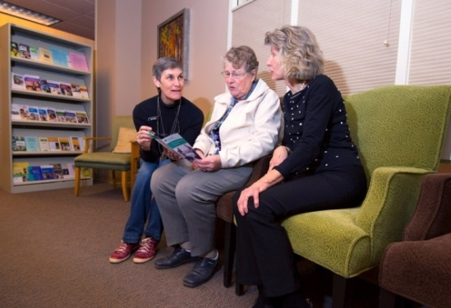
Patient and Family Counselling Services
Support and counselling are a
vital part of coping
Individuals, couples and families
Support groups and programs
Information and referral to community services
Assistance and information about practical and financial concerns
Resources:
BC Cancer booklet “Financial Information for Cancer Patients”
Notes:
READ off slide
Offer any local information as required.

Slide 58
Nutrition Services
Oncology Dietitian available at each Cancer Centre
Able to support you with difficulty eating, drinking, swallowing or maintaining your weight
Ask for a referral
Resources:
BC Cancer Website - Coping with Cancer
Nutritional Support: BC Cancer
Health Link BC
Dial 8-1-1 for general nutrition questions or
Speak with a specialized Registered Dietitian
Resource: “Eating Well When You Have Cancer”
Notes:
Read off slide
Offer any local information as required.

Slide 59
Speech-Language Pathology
Cancer and its treatments can affect voice, swallowing, speech, language, and quality of life.
Speech Language Pathologists can help you manage communication and swallowing issues
Patients with head and neck cancer may benefit from doing swallowing exercises before beginning treatment.
Can help if you are having difficulty swallowing pills
Ask your nurse or doctor for a referral
Resource: BC Cancer website – Coping with Cancer
Speech Language Pathology
Notes:
Read off slide.
Emphasize that these side effects are most common for patients with head and neck cancers but they may also occur with other types of cancer.

Slide 60
Library Services
Librarian available at each BC Cancer Centre
Resources:
Books, pamphlets, audio and videotapes
Cancer, treatment, coping with cancer, care-giving, healing, relaxation, sexuality and other topics of interest
Notes:
Read off slide

Slide 61
QUESTIONS?

