Slide 1

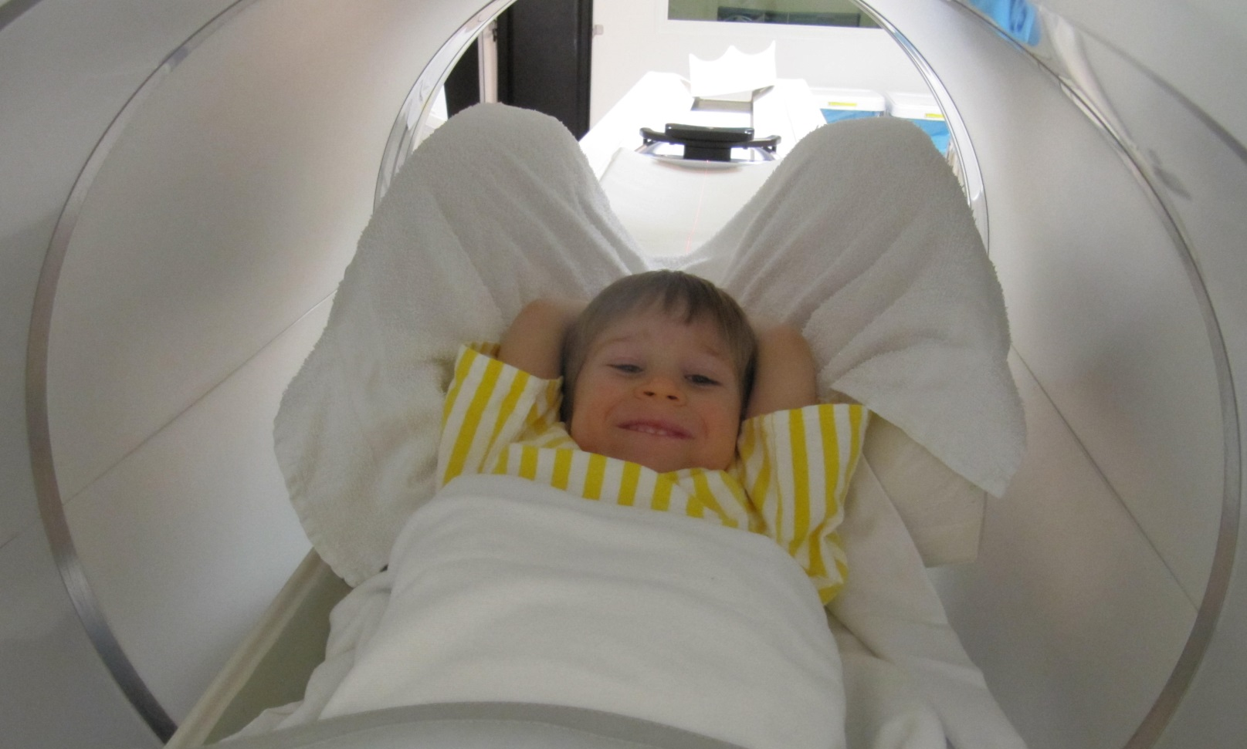
Pediatric PET/CT at
BC CANCER-Vancouver

Slide 2


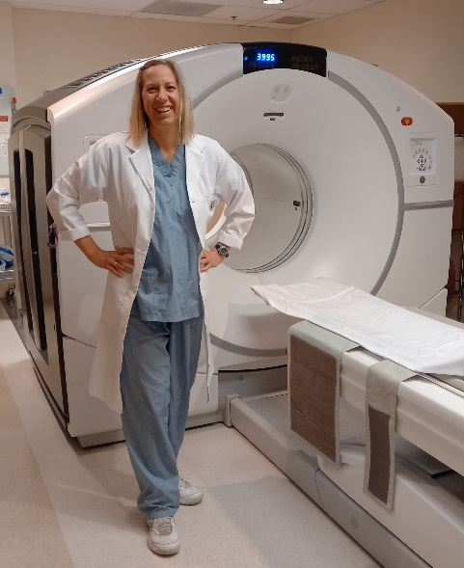
Introduction
A PET/CT scan is a type of test that uses a computer to give doctors detailed pictures of the human body.
A PET scanner looks similar to a CT or MRI machine with a round, donut shaped hole in the middle. The scanner part of the machine does not touch you and the scan will not hurt.
You will meet one of our kind and friendly Technologists, who will help you through your PET/CT appointment!

Slide 3


Before my PET/CT Scan
For this test you will not be allowed to eat or drink anything
other than water for 6 hours before your PET/CT appointment.
(Children having sedation must not have anything to eat or drink- including water for 12 hours before)
To get the best scan possible, it is important your body is hungry!
If you are wearing metal-free clothing (no zippers!)
you won’t have to change clothes.
When you come to the PET/CT clinic you
can bring a toy or a stuffy from home
that can stay with you the whole time.

Slide 4

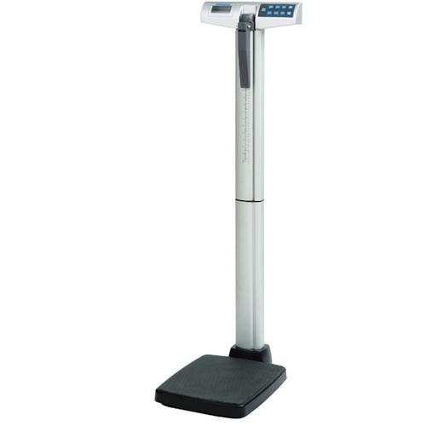

When I arrive at the PET/CT Clinic
You will be at the PET/CT Department for 2 hours.
Once you check in, there will be paperwork for your caregiver
to fill out in the waiting area.
When it is your turn, a Technologist will come and get you and
your caregiver.
The Technologist will measure your weight
and height, then give you a set of pajamas to
change into if your clothes have metal in them.

Slide 5
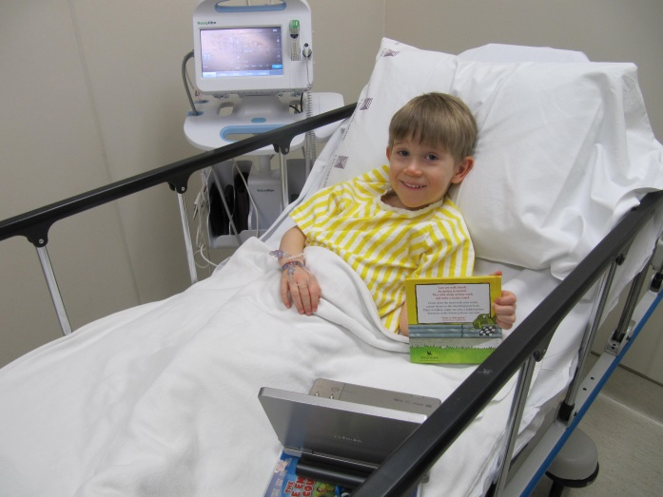
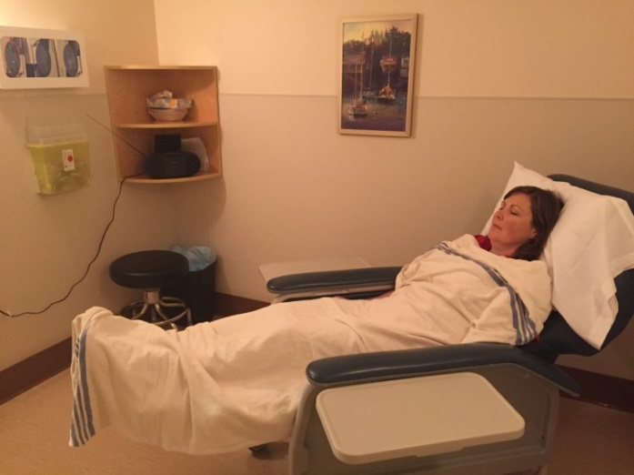
Preparing for my scan
The Technologist will make sure you are comfortable in the exam room where you will be for the next hour.
Depending on the schedule and how you are feeling, you may get a stretcher to lay on or a recliner chair.
You may choose music to listen to or watch a movie- you can even bring your own!

Slide 6
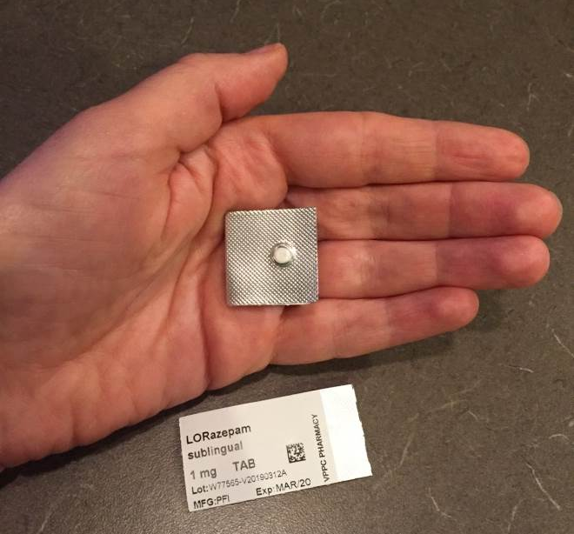
Ativan
The Doctor may ask that you have a medicine called Ativan at the beginning of your PET scan appointment. The very small pill dissolves under your tongue.
This medicine makes your muscles relax to give better pictures, and you may feel a bit sleepy from this medicine!

Slide 7
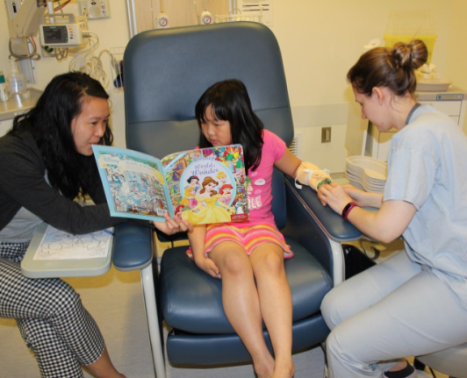
Placing the IV (Intravenous)
The technologist will put an IV in your arm or hand so that they can give you the radioactive sugar tracer. This special sugar has an important job! It sends signals to the PET scanner, which will make a picture of your body for the doctors to look at.
The Technologist will tie a stretchy elastic band around your arm before inserting
the IV into a vein in your arm or hand.
Some kids like to blow bubbles or watch a movie as they prepare for the IV start.

Slide 8
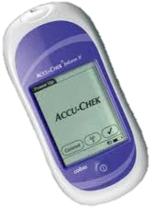
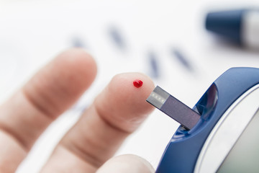
Blood Sugar Check
At the same time the technologist is putting in your IV, they will take a small drop of blood to check your blood sugar level. This tells us that your body is hungry, and it will be a good scan!
If you come to your PET/CT appointment with an IV already, the technologist will need to do a little pin prick in one of your fingers to get a drop of blood.

Slide 9
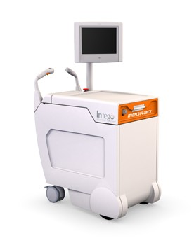
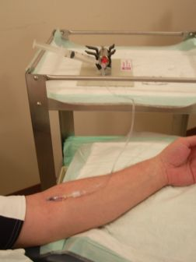
Getting the Tracer
The sugar tracer is brought into your exam room on either a special cart, or a machine like in the pictures below.
The tubing from the tracer is attached to your IV. When the tracer goes in, there’s no pain. Your arm might feel a bit cool from then injection, and sometimes there’s a slight vibration from the automatic injector.

Slide 10
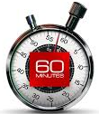
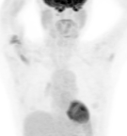
Uptake Time
In order to get good pictures of your body, we need to let the tracer circulate inside you for 1 hour before the scan starts.
This hour is called the “uptake time” and you will stay resting comfortably in the exam room. You can listen to music, or watch a movie, but we ask that you try to rest your muscles as much as possible.
This person was playing a video game with lots of button
pushing, which made the tracer go to their arm muscles!

Slide 11
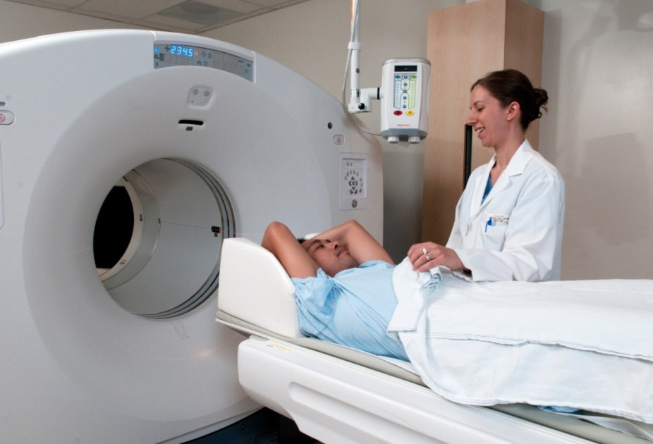
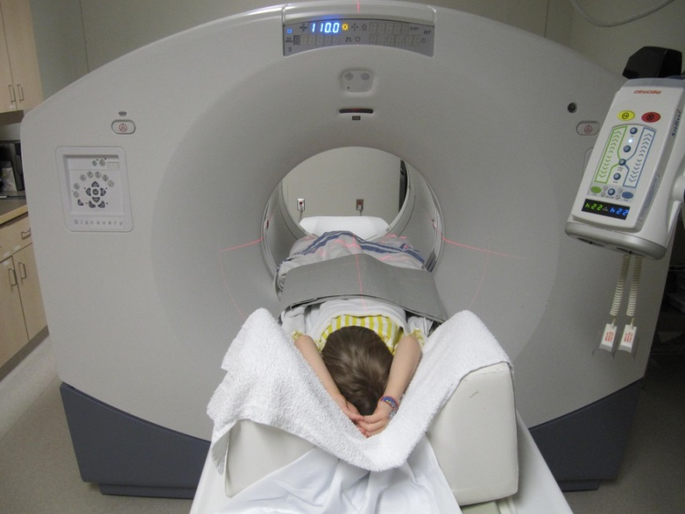
PET/CT Scan
After you’ve had a chance to go pee in the bathroom, the Technologist will position you on the scanner bed. Your caregiver can come with you.
Sometimes you will go head first, but usually you will go feet first.
You will have your arms up, unless the Doctor asks for them down in the picture.
Red lights are used to make sure you’re really straight for your scan.

Slide 12
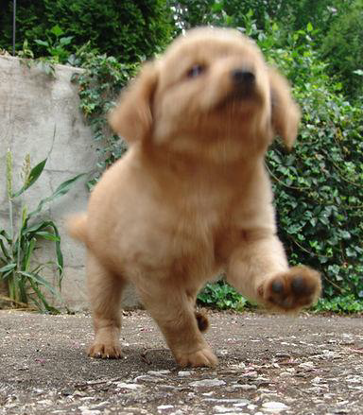
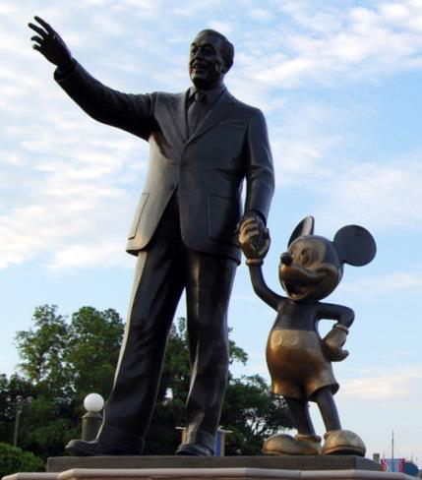
Still as a Statue
Have you ever tried taking a picture of something that is moving? It gets blurry just like this puppy photo!
Your very important job is not to move during your scan, so that the PET machine can take good pictures. You will be able to breathe normally for your whole scan.
Hold still, just like this statue!

Slide 13
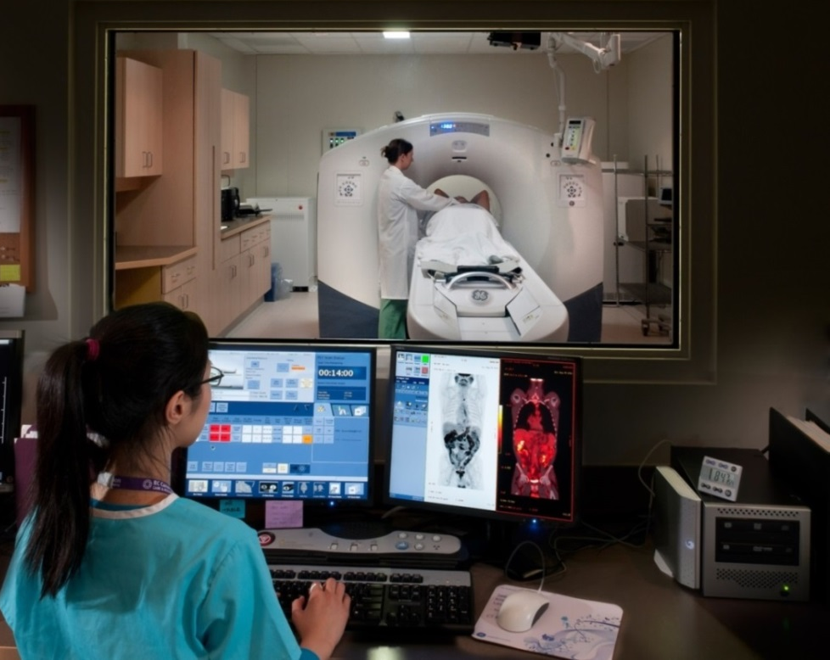
PET/CT Scan
A Technologist can see you and hear you from the Control Room the whole time.
Most scans take about 30 minutes to go from head to toe- but this will depend on YOUR height and weight.

Slide 14
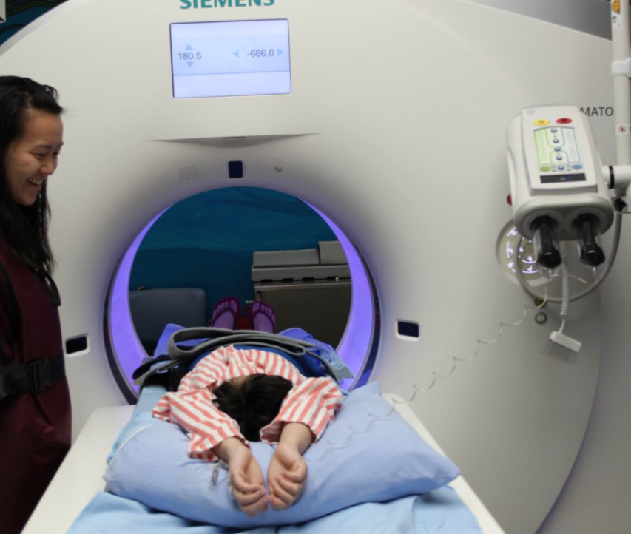
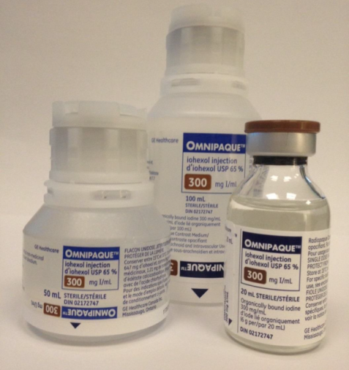
IV CT Contrast
Some kids get a medicine called contrast that helps the pictures. This medicine goes into your body, at the beginning of your scan, through the same IV.
When the contrast goes in, you might feel warm on the inside. Sometimes people say it feels like they peed their pants! (Don’t worry though- that won’t happen, and the feeling goes away after a minute.)

Slide 15
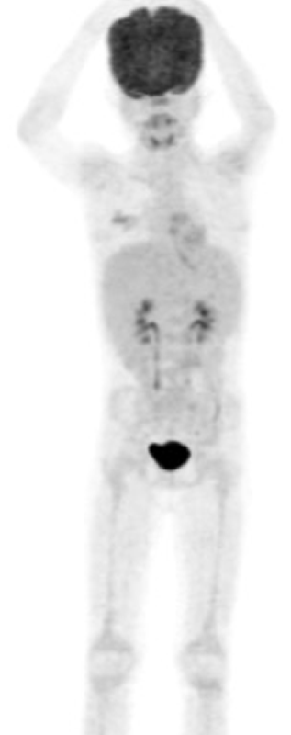
PET Scan Image
Brain
Here is an example of a PET picture, and the body parts we can see:
Salivary Glands
Heart
Liver
Spleen
Kidneys
Bladder
Growth plates

Slide 16

Radiation Safety:
Two Sources of Radiation
1. The Scanner
There is radiation during the CT portion of the exam-
your family waits outside the door for this 1 minute scan.
2. You
The radioactive tracer disappears quickly on its own.
After 6 hours only a small amount is left.
Your urine is radioactive, so drink and pee lots to get rid of it!
We recommend that you not spend long periods of time within 2 meters of other children and/or pregnant women for 6 hours after the PET tracer injection.
If it is necessary to travel by air, or to the USA after the PET scan, please inform the Technologist who will give you a travel letter.

