Slide 1
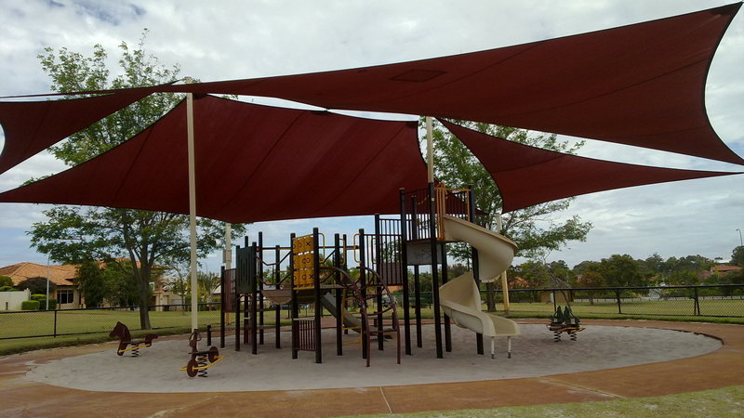
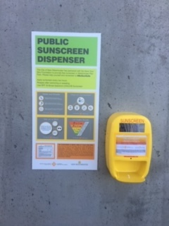
WHAT WE DO To work collaboratively to reduce the risk of exposure to UV and its damaging effects through policy and health protection measures and by providing health promotion messaging and education to people in BC, with a particular focus on infants, children and youth.
Sun Safe BC
Year 1 Report Apr 2019 - Mar 2020
CURRENT PROJECTS
City of Vancouver shade project - design and implement shade solutions for 5 City-owned childcare sites with heavy sun exposure.
Sunscreen Dispenser Program – place sunscreen dispensers at select park locations in spring/summer months.
Professional development course on sun safety for Early Childhood Educators – develop a 2-hour course to be offered at West Coast Childcare Resource Centre in summer 2020 and explore online options.
COALITION MEMBERSHIP
BC Centre for Disease Control
BC Cancer
UBC Dermatology
Save Your Skin Foundation
Canadian Cancer Society
CAREX Canada
Canadian Dermatology Association
Vancouver Coastal Health
Simon Fraser University
BC Children’s Hospital
ACTION AREAS
CAPACITY FOR ACTION - Strengthen capacity among priority population service providers and educators;
SUPPORTIVE ENVIRONMENTS - Create and strengthen supportive environments to limit exposure to UVR exposure;
POLICY & DECISION MAKING – Inform decision making and seek to influence sun safe policies advancing toward provincial policy creation or amendments when and where possible;
ATTITUDE, KNOWLEDGE & BEHAVIOUR - Influence and improve attitudes, knowledge and behaviour around sun safety and develop individual skills to keep healthy and avoid UVR damage.
ACHIEVEMENTS
6 coalition meetings with presentations from guest experts.
3 key partnerships formed:
City of Vancouver re: shade solutions at childcare sites.
City of New West & Save Your Skin Foundation re: sunscreen dispenser initiative.
West Coast Childcare Resource Centre re: sun safety training for Early Childhood Educators.
1 sunscreen dispenser installed at New West’s riverfront park.
FUTURE PLANS
Expand coalition to include new strategic partnerships.
Work more collaboratively with other provinces, e.g. Alberta.
Expand sunscreen dispenser initiative and City of Vancouver shade project.
Convert sun safety training to online format.
Establish a long-term sustainability plan for coalition.

