Slide 1
How are we doing? Quality in Breast Cancer Care
Dr Michelle Goecke
Surgical Oncology Network Update
October 18, 2014

Slide 2
Disclosure
Relationships with commercial interests: None

Slide 3
Quality of Care
“ the degree to which health services for individuals and populations increase the likelihood of desired health outcomes and are consistent with current professional knowledge”
Institute of Medicine, 1990
Notes:
Providing quality health care is what we are all striving to provide, whether doctors, nurses, allied health care practioners, we want the best for our patients.
How do we measure quality of care?

Slide 4
Quality Indicators
Based on standards of care
Relevant, measurable and within the control of those delivering the care
Different types
Performance/processes of care
Outcome
Notes:
Through Qis Which are based on standards of care, they are evidence based
The indicators provide a quantitative basis for clinician, organizations to achieve improvement in care and the process by which care is provided
Performance – slnbx in early stage breast cancer
Outcome – disease free survival, local recurrence

Slide 5
Quality Indicators in Breast Cancer Care
Diagnosis
Surgery
Local regional treatment
Systemic treatment
Staging
Counselling, Follow-up and Rehabilitation
Notes:
Data I will show you looks at some of the surgical indicators.

Slide 6
Quality Indicators in Breast Cancer Care
Level of
Evidence
Mandatory/
Recommended
Minimum
Standard
Indicator
Target
Notes:
7 on diagnosis
4 on surgery/loco-regional treatment
9 systemic treatment

Slide 7
Quality Indicators in Breast Cancer Care

Slide 8
Breast Cancer Care in British Columbia

Slide 9
SON Breast Tumour Group Quality Measures
Core biopsy diagnosis
Orientation of surgical specimen
Radiologic confirmation of fine wire specimens
Sentinel lymph node biopsy in early stage breast cancer
Margin details noted in operative report
Clips in cavity after breast-conserving surgery
Notes:
In 2009, the BTG selected aspects affecting breast surgical outcomes to review to understand

Slide 10
Breast Cancer Care in British Columbia
SON Breast Tumour Group Quality Measures
BCCA Breast Cancer Registry
Breast Cancer Outcomes Unit (BCOU)
Fraser Health Clinical Audit
Mt. St. Joseph’s Rapid Access Breast Clinic Audit

Slide 11
Breast Cancer in BC in 2011
4129 new diagnoses
Mean age 61
86% referred to the cancer agency
88% Invasive carcinoma
90% Early Stage
Notes:
3548 referred, 3115 88% invasive, 12% 433 dcis, 3196 90% had early stage <=3A
Age range 16-103

Slide 12
Breast Cancer in BC in 2011
Surgical Management
29%
44%
48%
67%
Notes:
I was not able to obtain good margin data, number of re-excisions nor reliable data on reconstruction.

Slide 13
QI: Preoperative Definitive Diagnosis
Patients with breast cancer should have a non-operative histological diagnosis
Rationale
Reduces number of unnecessary operations
Plan treatment
Patient counselling
Target 90%
Notes:
Preoperative definitive diagnosis with a tissue biopsy - To reduce the number of unnecessary operations, to plan complete assessment and treatment as wel as pt counselling

Slide 14
QI: Preoperative Definitive Diagnosis
The utilization and impact of core needle
biopsy diagnosis on breast cancer outcomes
in British Columbia
BCMJ, Vol. 56, No. 4, May 2014, page(s) 183-190
Kristy Cho, Scott Tyldesley, MD, FRCPC, Caroline Speers, BA, Barbara Poole Lane, MPA,
Karen A. Gelmon, MD, FRCPC, Christine Wilson, MD, FRCPC
Study results indicate that open surgical procedures
are being overused for the diagnosis of breast cancer
in BC’s more sparsely populated regions.

Slide 15
QI: Preoperative Definitive Diagnosis
MSJ Rapid Access Breast Clinic 2012
Preoperative core biopsy diagnosis | (534) 96%
Surgical biopsy diagnosis | (23) 4%
Notes:
557 patients

Slide 16
QI: Preoperative Definitive Diagnosis
FHA Clinical Audit 2012
Notes:
Target 90%

Slide 17
QI: Radiologic Confirmation of Fine Wire Specimen
Rationale
Most DCIS and 60% Stage 1 cancers are imaged detected requiring image localization
Need to document successful target excision
Used for pathologic and radiologic correlation
Notes:
Most of stage 0 and 60% of stage I breast cancers are image-detected and will involve
some form of image localization (1).Specimen radiography or specimen ultrasonography should routinely be performed for all
excisions of image-detected abnormalities to document success of the procedure in excising the target (2 -6).
• Specimen radiography may also help document adequacy of excision margins grossly, whether the lesion presented as microcalcifications or as a mass (2-6).2
Specimen radiographs should always be presented to the pathologist for radiographic andpathologic correlation (2).

Slide 18
QI: Radiologic Confirmation of Fine Wire Specimen
FWL Procedure | N (%)
Image done, lesion seen | 1075 (80)
Image done, lesion not seen | 21 (2)
No image done | 46 (4)
Unknown if image done/lesion seen | 189 (14)
Target: 100%
BCOU Data 2011

Slide 19
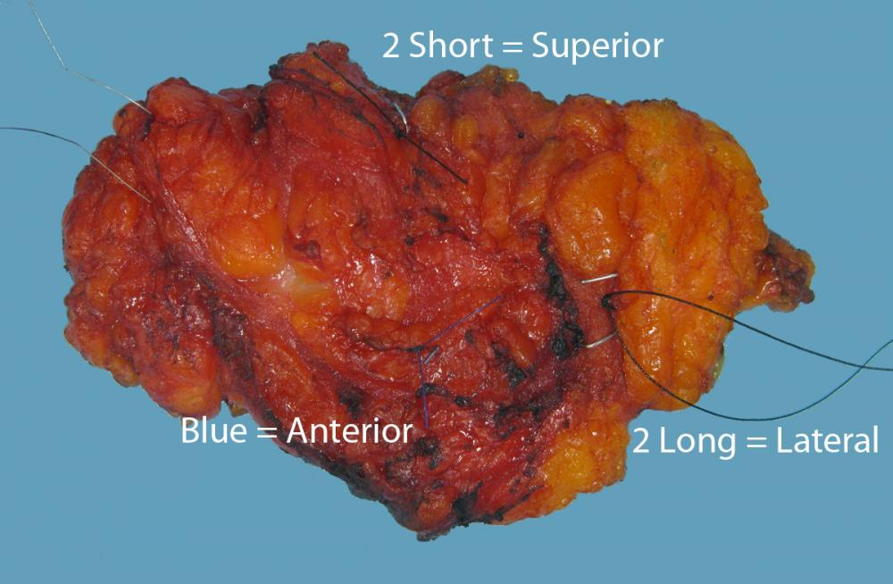
QI: Orientation of Surgical Specimen
To determine the location of the margin pathologic status
Margin status strongly correlates with local recurrence rate
Allows for targeted re-excision
Target: 100%
Notes:
Breast specimen orientation is crucial to determine the location of surgical margin pathologic status. Margin status strongly correlates with the local recurrence rate and the subsequent need for reexcision.
Multiple breast specimen orientation techniques may be used (these include stitches, clips and ink).
For those patients with known or suspected breast carcinoma undergoing preserving surgery, proper breast specimen orientation allows for targeted re-excision. A non-oriented specimen may lead to increased volume loss, worse cosmesis and lower likelihood of successful breast
preservation. Specimen orientation is also necessary In patients undergoing excisional biopsy after a minimally invasive breast biopsy demonstrated a “high risk” lesion of the breast because breast cancer
may be identified. High risk lesions include but are not limited to any lesion with atypia or lobular carcinoma in situ.

Slide 20
QI: Orientation of Surgical Specimen
 | Oriented Specimen
BCOU 2011 | 85%
FHA 2012 | 92% (3 of 9 sites 100%)
Notes:
In fha 3 of 9 sites had 100%

Slide 21
QI: Surgical Approach to the Axilla
Patients with invasive breast cancer and clinically node negative should have a sentinel lymph node biopsy
Rationale
LN status is important for prognosis and treatment planning
SLNBx is the accepted means of staging in clinically node negative patients
Target: 95%

Slide 22
QI: Surgical Approach to the Axilla
 | SLNBX in Early Stage Breast Cancer
BCCA/BCOU 2011 | 80%
FHA 2012 | 81%
MSJ 2012 | 95%
Target: 90-95%

Slide 23
Summary
QIs exist for all aspects of breast cancer care
Data on QIs is difficult to collect and extract
There is room for improvement in British Columbia
Synoptic reporting can improve data collection

Slide 25
