Slide 1
Guidelines for Neoadjuvant Therapy in Breast Cancer:
The Canadian Perspective
Christine Simmons, MD MSc FRCPC
Medical Oncologist, BCCA Vancouver
Assistant Professor, University of British Columbia
Founder and Chair, All in Cancer/Women in Cancer
www.allincancer.org

Slide 2
Disclosures
Honoraria:
  Roche, Amgen, Novartis, AstraZeneca, Genomic Health
Advisory Role:
  Roche, Amgen, Novartis, Genomic Health, AstraZeneca
Research Funding:
  Roche, Amgen, Novartis, Genomic Health, AstraZeneca, Esai

Slide 3
Objectives
To discuss the role of neoadjuvant therapy in management of breast cancer
To present current Canadian guidelines for neoadjuvant therapy in breast cancer cases
To highlight key areas of continued development

Slide 4
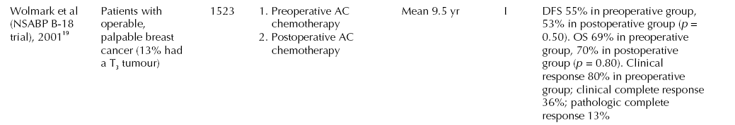
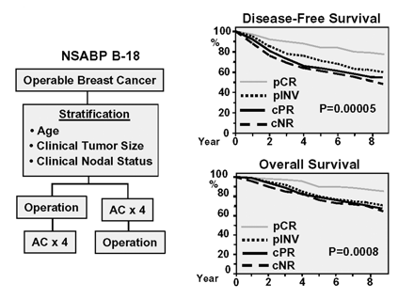
This is not a new concept!
NSABP B-18
Wolmark, JNCI 2001.

Slide 5
Initial studies with NAT
NSABP B18
  No difference in DFS or OS in patients receiving pre-op vs. post-op chemo
  Chemo used was AC x 4
  Era pre-taxane, pre-Her2 testing
Demonstrated there was no harm in “delaying” surgery
  And we did learn about prognosis in pts with pCR

Slide 6
Benefits of NAT in drug development?Can it help us “Pick the Winner”?

Slide 7
Why are we considering this?
Clinical Importance of NAT
Render an inoperable patient potentially operable
  Inflammatory breast cancer
  Inoperable LABC
Increase surgical options
  Lumpectomy in patient who had previously required mastectomy
Know if the chemo we were going to give in adjuvant setting has any effect on this tumour in this patient

Slide 8
So we have the “why”…
What about the WHO?
The WHAT?
The WHEN?
The HOW?
Do we have a guideline????

Slide 9
Do guidelines exist to help inform our practice?
Clinical practice guidelines for the care and treatment of breast cancer: 15. Treatment for women with stage III or locally advanced breast cancer. CMAJ, Shenkier et al. 2004
  True Guideline
  But a bit outdated?
Recommendations from an international consensus conference on the current status and future of neoadjuvant systemic therapy in primary breast cancer. Ann Surg Oncol, Mamounas et al. 2012
  Consensus statement, not true guideline
  Applicability to Canadian practice?
BCCA Cancer Management Guideline
  Neoadjuvant therapy posted April 2013
  Not true guideline

Slide 10
Hot off the press
Documents in press
  “A Canadian National Expert Consensus on Neoadjuvant Therapy for Breast Cancer: Linking Practice to Evidence and Beyond” Simmons et al. Current Oncology, in press
    Expert consensus developed using Delphi methodology
    Systematic review of literature
    Somewhat meets criteria for guideline as per AGREE II
  “Locoregional Management of Patients undergoing neoadjuvant therapy” Cancer Care Ontario PEBC, Brackstone et al. www.cancercare.on.ca
    True guideline as per AGREE II
    Systematic review of literature

Slide 11
What will these updated guidelines tell us?
Who should be offered NAT
Who can be offered NAT
What workup needs to be done prior to starting NAT?
How should patients be followed while on NAT?
What locoregional management should be offered after NAT?

Slide 12
A Canadian National Expert Consensus on Neoadjuvant Therapy for Breast Cancer
Modified Delphi protocol utilized to gain consensus on all key aspects in pathway of care
  Pre-specified level of consensus reached if >80% of experts agreed
  Consensus achieved after 3 iterative surveys issued
    Role of MRI in NAT did not achieve consensus
Systematic review of all published RCTs of patients undergoing NAT
  Pathway of care utilized/followed in RCTs compared to consensus pathway of care to determine if expert opinion reflects evidence

Slide 13
Who SHOULD be offered NAT?
Experts from across Canada answered
  Locally Advanced Breast Cancer (LABC) is often defined as: T3 or T4 tumours with any clinical N status, or any size tumour with N2 or N3 disease.
  Inflammatory breast cancer (IBC)
  Can be operable or inoperable upon presentation
100% of experts agreed NAT strongly recommended in pts with LABC or inflammatory breast cancer
Consistent with evidence of use of NAT

Slide 14
Who else?
Anyone who would be offered adjuvant therapy can be offered neoadjuvant therapy
But should they?
Are some subtypes of breast cancer more appropriate than others?

Slide 15
Benefit, more or less?
Von Minckwitz
  Data from 6377 patients enrolled in 7 clinical trials
  pCR, DFS, OS and subtype information available
Analyzed pooled data to determine any change in response based on subtype
  Luminal A
  Luminal B, non-Her2
  Luminal B, Her2+
  Her2+, non luminal
  Triple Negative
Von Minckwitz et al, JCO 2012

Slide 16
Response Rates by Subtype

Slide 17
The Ideal Patient for NAT
Inflammatory breast cancer patients should be offered NAT
  Strongly recommended
LABC
  Strongly recommended
Patients who would be offered adjuvant therapy
  Any clinically node positive patient, favoring those with higher risk features
  Clinically node negative patients with many high risk features

Slide 18
Are “Guidelines” reflective of “Real Life”
Who is being offered NAT currently?
What are the outcomes for pts getting NAT in “real life”?

Slide 19
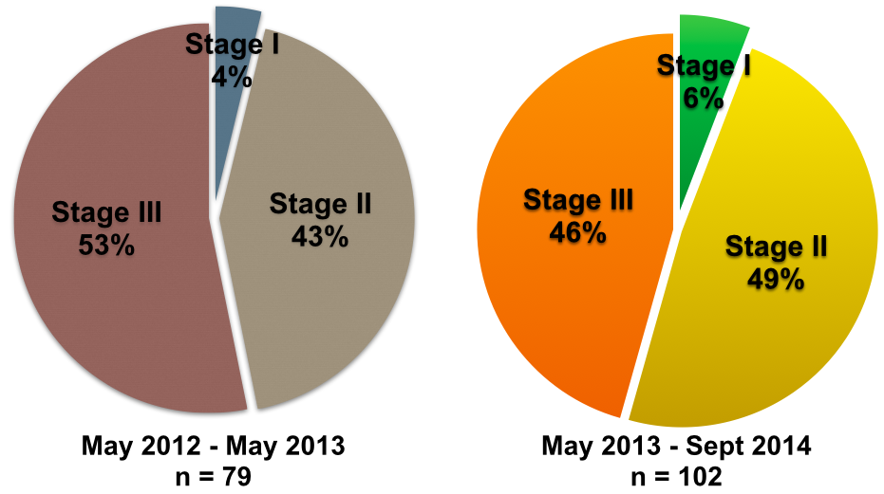
Who is receiving NAT at BCCA Vancouver by Stage

Slide 20
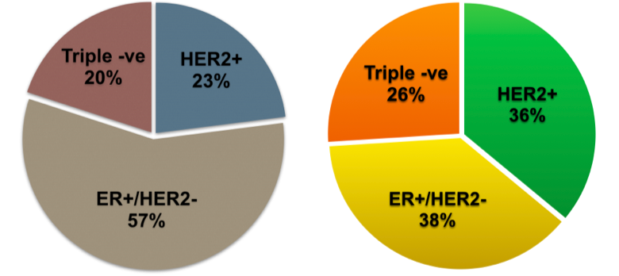
Who is receiving NAT at BCCA Vancouver by Subtypes
May 2012 – May 2013
n = 79
May 2013 – Sept 2014
n = 102

Slide 21
What workup needs to be done in patients undergoing NAT?
Expert consensus 100% agreement:
  Biopsy
    Receptor status on core (ER, PR, Her2 status)
  Imaging
    Breasts
    Bones
    Body
  Clinical exam and documentation of size of tumour/nodes
  Cardiac workup if at risk of cardiotoxicity
Consistent with methodology in literature

Slide 22
Workup nuances/Things a guideline may never be able to capture
Clip placement
  Clip in tumour landmarks location of malignancy which may be lost if patient has complete clinical response
  Also allows pathologist to focus interrogation of surgical specimen in this area
Who should organize workup?
  Local practices may differ
  Importance of team approach to ensure that timely workup and complete workup is obtained

Slide 23
How should patients be followed?
Expert consensus 98%:
  Clinical assessment with tape measure or calipers at each cycle of therapy
Role of Radiographically assessing response?
  Canadian Radiological guidelines suggest use of MRI to detect response to NAT in breast ca pts
  Clinical exam also works and is more pragmatic at each cycle
  Expert consensus against repeated radiographic assessment
  Lack of consensus as to overall role of MRI for patients undergoing NAT
Importance of consistency
Importance of repeated measures throughout course

Slide 24
How do we know NAT worked?
Clinical response
Pathological response
  What is pCR?????
    Defined variably in the literature and changes from study to study!
Canadian consensus definition of pCR
  “No invasive disease found in breast or in axilla”
  Overall more conservative than literature
  Usually expected rate of pCR for all patients roughly 20-25%

Slide 25
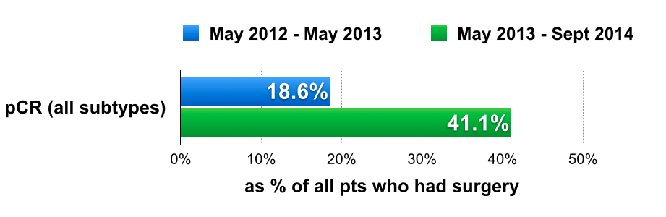
What is the rate of pCR in “real life”?
Retrospective data: Of the 70 pts who had surgery, 13 had a pCR (13/70)
Prospective data: Of the 56 pts who have had surgery, 23 had a pCR (23/56)
p = 0.00544
Notes:
THANKS DR. CHIA YOU ROCK

Slide 26
Loco-regional Management
Patients with clinically node positive LABC at diagnosis should preferably have adjuvant radiotherapy to include regional lymph nodes (infraclavicular/supraclavicular) regardless of the pathological response
  87% agreement amongst Canadian experts
  Consistent with methodology in clinical trials, with a tendency towards more aggressive approach
Lumpectomy is an option for the surgical management of patients who receive neoadjuvant therapy
  83% agreement amongst Canadian experts
  Consistent with methodology in clinical trials

Slide 27
Beyond surgery and radiation?
“In the setting of residual disease at the time of surgery, no further therapy beyond adjuvant radiation therapy and targeted therapy (endocrine or trastuzumab, based on receptor status) is needed outside of clinical trials”
  100% agreement amongst experts and consistent with current literature
  In Her2+ patients trials are open and ongoing
  Likely trials to open soon in setting of Triple negative disease

Slide 28
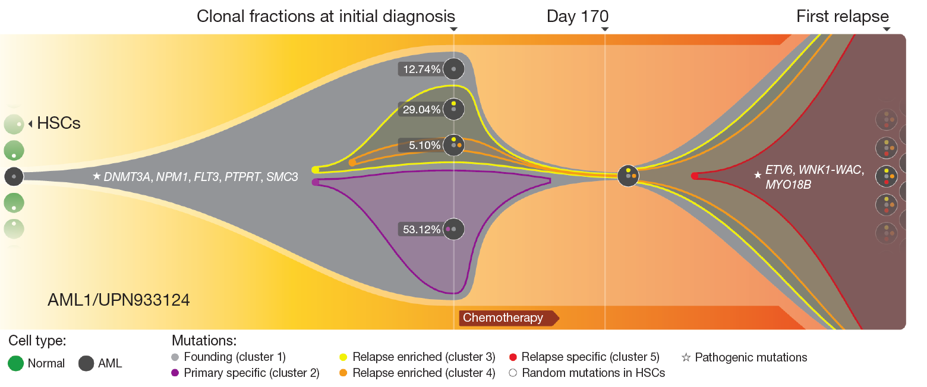
“Darwinian” Evolution of Mutation
Possible clonal selection due to treatment?
? Survival of the Meek?

Slide 29
Being mindful that we work as a team
NAT in patient with clinically negative nodes
  T2N0 no high risk features
    Will this patient need adjuvant XRT to the axilla?
    We may never know!
      Risk of under-treatment/over-treatment of the axilla
      Role of SLNB pre-chemo in highly selected patients
In the context of adjuvant studies
  Z011 (no need for completion ALND if SLN+)
  MA.20 (need to radiate axilla even if <4 LN+)
  AMAROS (radiation just as good as ALND if SLN+)

Slide 30

Collaborative approach is necessary for Clinical Care AND Research!
ONCOLOGY
SURGEONS
RADIOLOGY
PATHOLOGY
PATIENT
FAMILY MD
RADONC
NURSING

Slide 31
Conclusions
NAT is strongly recommended in:
  Inflammatory breast cancer
  LABC
    Canadian definition Stage IIb and all of Stage III disease
NAT an option to consider in patients who would be offered adjuvant chemotherapy
  Certain subtypes may be more appropriate
    Triple negative subtype
    Non-luminal Her2+ subtype
Workup of patient prior to NAT must include
  Receptor status assesement on core
  Radiographic assessment of axillary nodes and FNA of suspicious nodes
  Imaging of body based on clinical stage to rule out mets
But be mindful that axillary staging may not capture original burden of disease
  Results of ongoing studies may help to answer this question
Lumpectomy may be an option for patients undergoing NAT

Slide 32
Thank you!
www.womenincancer.org
www.allincancer.org

