Slide 1


Margins: less is just as good?
SSO/ASTRO Consensus Guideline on Margins for BCS
Rebecca Warburton MD FRCSC
Mount Saint Joseph Hospital
October 18, 2014

Slide 2
No disclosures

Slide 3
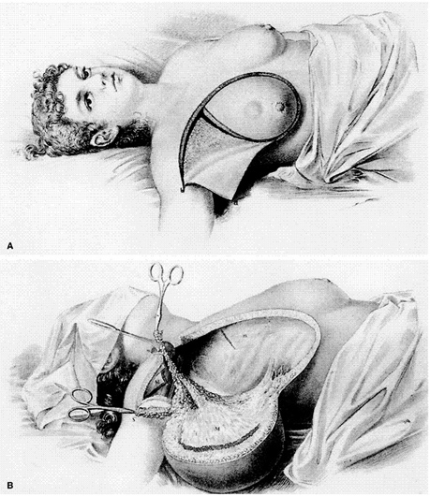
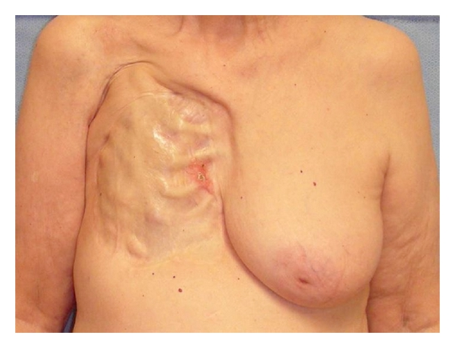
What used to happen….

Slide 4
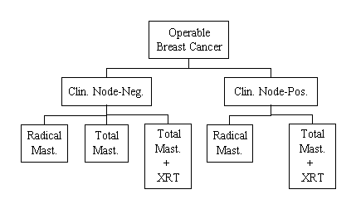
NSABP B04
Bigger isn’t better
At 3, 5, 10 and 25 years:
DFS – no difference
DDFS – no difference
OS – no difference
LRR – node –ve: RM 9%, TM 13%, TM+RT 5%
node +ve: no difference
LESS AGGRESSIVE SURGERY, AVOID RM, NO NEED TO ADD RADIATION TO TM
Notes:
NSABP B04 – first reported 1977
Fisher et al 2002
RCT
N=1079 node negative pts
2 arms – node + and node –
No systemic treatment
RM v. TM+RT v. TM

Slide 5
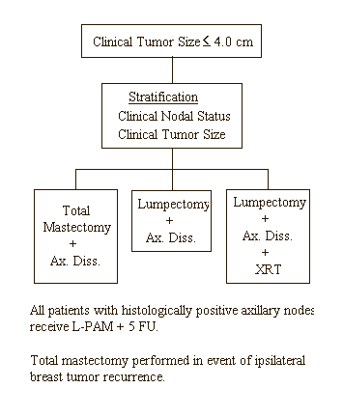
NSABP B06
Even less is just as good
NO DIFFERENCE IN DFS, DDFS or OS
LRR
MRM 10%
L+ALND 39%
L+RT+ALND 14%
MUST ADD RT TO BCS
BCS = M but higher LRR
Notes:
NSABP B06
RCT
n=2163
Node pos chemo
Lumpectomy – 50Gy rads
1976-1984
Outcome – ipsilateral BC recurrence
One of the few early studies that required microscopically clear margins - NO INK ON TUMOUR. Most used grossly clear margins

Slide 6
BCS
Specific issues:
  Commitment to radiation
  Cosmesis
  Re-operation
  In Breast Tumour Recurrence
No Difference in Survival
MARGINS

Slide 7
BCS: Re-operation
Rates vary – 20-50%
Rate of re-operation depends on margin
Quality indicator:
  Rate of re-operation
  Rate of BCS failure (completion mastectomy)
Impact of Re-operations
  Patient: stress, cosmesis, delay to adjuvant treatment
  System: cost, wait times
  Does it impact outcomes?

Slide 8
BCS: Re-operation
Providence Health Care Breast Clinic
Institutional review – 2012-2013
1076 BC surgeries on 996 patients
Primary Surgery:
408/996 (41%) – TM
588/996 (59%) – BCS
Re-operation – 113/588 (19%)
51/113 (45%) – completion mastectomy
51/588 (8.7%) – BCS failure
62/113 (55%) – re-excision of margins
CSF 2014
Notes:
Should have an idea of BCS rate, re-operation rate and BCS failure rate
Path from re-excision specimens is in our database but haven’t analyzed
Most studies show residual disease in less than 20-50%

Slide 9
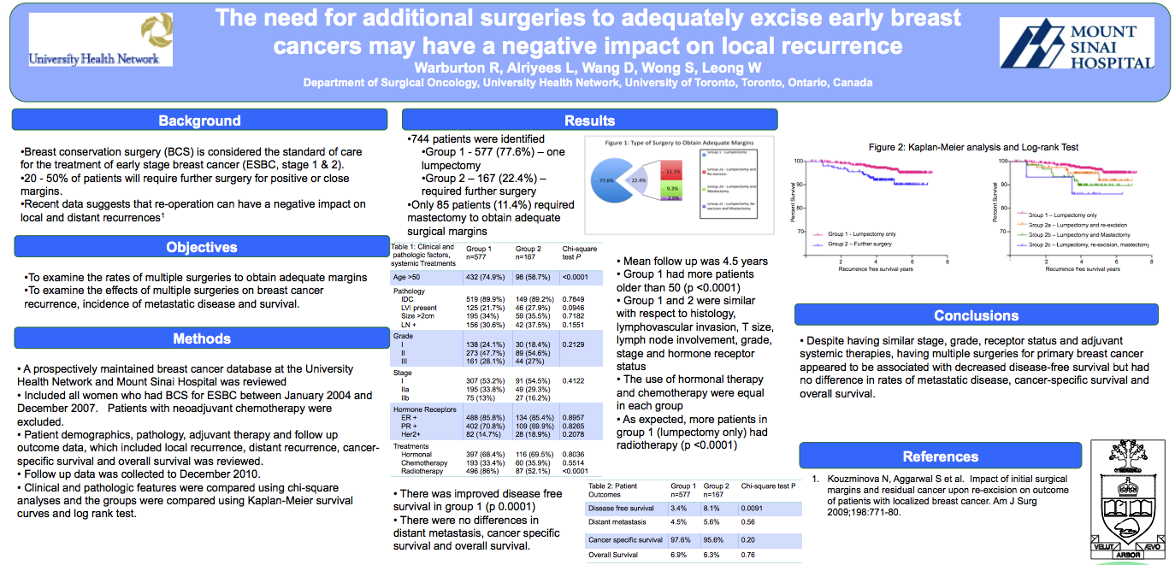
BCS: Re-operation
Does it impact outcomes?
SABCS 2012

Slide 10
BCS: Re-operation
Does it impact outcomes?
SABCS 2012

Slide 11
BCS: IBTR
NSABP B06 – IBTR 14%
More recent data – lower rates
  Improved imaging and pathologic evaluation
  Aware of margin status
  Adjuvant treatments
    More indications for systemic treatment
      Chemotherapy
      Endocrine
    Radiation

Slide 12
BCS: IBTR
NSABP B06 – IBTR 14%
More recent data – lower rates
  Veronesi 2002 – 20yr follow up
    BCS (15mm margins) LR – 8.8%
  Toronto – LRR: BCS 3.5% @ 5 years
  MDA 2013 – prospective cohort of 2331
    BCS - LR – 3% @ 5 yrs, 6% @ 10 yrs

Slide 13
BCS: IBTR
Breast Cancer Outcome Unit - BCCA
  2435 patient T1-3, Nany, M0
  Treated with BCS and radiation +/- boost
    Recurrence @ 5.2 yrs
      Local – 1.5%
      Regional – 1.1%
      Distant – 5.6%
    Margin – close/positive increased LR (4.0/5.2%)
      No change to RR, DR, BCSS and OS
Lupe, et al. Int J Rad Onc Biology 2011

Slide 14
BCCA – Margin Guideline
July 2001
General Considerations
  For most patients it is reasonable to try to achieve an ipsilateral breast tumour recurrence (IBTR) rate of <1% per year. The addition of a radiation boost to the tumour bed reduces the risk of IBTR. However, re-excision to obtain negative margins reduces IBTR more than using a radiation boost. The use of systemic therapy also reduces IBTR. For patients with a high systemic failure risk (for instance those with numerous positive axillary lymph nodes), it may be reasonable to accept a higher risk of IBTR. It may also be reasonable to accept a higher risk of IBTR in patients for whom further local breast surgery would result in an unacceptable cosmetic result, or where there is a strong desire to avoid a mastectomy, or if medical problems preclude surgery.

Slide 15
BCCA – Margin Guideline
July 2001
Guidelines for Re-excision and Radiation Boost following breast conserving surgery
  1. For patients with invasive disease, invasive or in situ disease at the margin will be treated in the same manner. 2. The definition of a negative margin is tumour > 2 mm from an inked margin. 3. A positive margin is defined as tumour touching ink. 4. A close margin is anything in-between. 5. Re-excision to obtain negative margins is recommended for patients with close or positive margins. 6. If a margin is < 2 mm and re-excision is declined or inappropriate, a radiation boost to the tumour bed is recommended.

Slide 16
BCCA – Margin Guideline
July 2001
Guidelines for Re-excision and Radiation Boost following breast conserving surgery
  7. Re-excision should be more strongly recommended where the risk of IBTR is high and systemic risk is low, for example:
    Margin < 2 mm and extensive intraductal component present age < 40 lobular histology lymphatic invasion present no systemic therapy given margin close/positive at multiple sites Margin status unknown Tumour touching inked margin at any site
  8. When the deep margin is positive, and the surgeon has dissected down to fascia, then a boost should be given
Patients with close or positive margins who decline re-excision should be advised that the risk if IBTR is increased. The relative risks/benefits of re-excision vs boost in the context of local control and cosmesis should be discussed.

Slide 17
BCCA – Margin Guideline
July 2001
Timing of Re-excision
  Early consultation with a radiation oncologist is recommended if there is uncertainty about whether or not re-excision is recommended. This will facilitate a timely re-excision. Generally, re-excision should be carried out as part of the definitive surgery and prior to adjuvant systemic therapy and radiation.
Lobular Carcinoma In Situ
  Lobular carcinoma in situ at the margins does not constitute a positive margin.
Pathology Reports
  If a pathology report does not contain the necessary information to determine margin status, then a BCCA pathology review should be obtained. If, after this, it is still not possible to accurately determine the margins, then the margins should be treated as unknown in which case a re-excision (or radiation boost) is generally recommended.

Slide 18
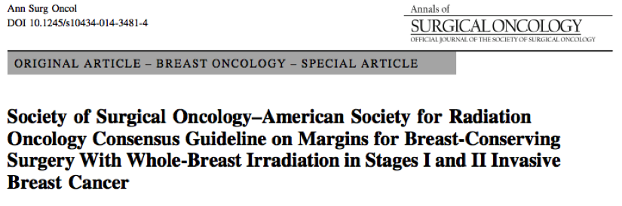
SSO and ASTRO multidisciplinary expert panel (MP: margin panel) – examine relationship between margin width and IBTR
What margin width minimizes risk of IBTR?
Also examined special circumstances that may have influence:
tumour histology
patient age
use of systemic therapy
technique of radiation

Slide 19
Methods:
Systematic review and meta-analysis - articles published 1965-2013
Inclusion/Exclusion
1. ESBC (excluded NAC, pure DCIS)
2. BCT (adjuvant radiation)
3. Microscopic margins reported quantitatively
4. Reported age data
5. Minimum median/mean follow up 4 years
Results: 33 studies with 28,162 patients
1506 IBTR (median prevalence 5.3%)
follow up 79.2 months
2 models: close/pos v. negative and positive v. close v. negative

Slide 20
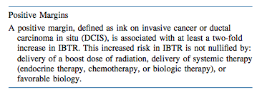
Close/pos v Negative – OR 1.96
Positive v Negative – OR 2.44
Close v. Negative – OR 1.74

Slide 21
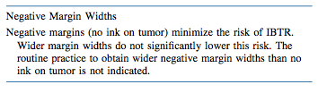
Microscopic distribution of tumour in breast in clinically and mammographically unicentric BC
  Holland et al - T1 tumours foci at 2cm (42%), at 3cm (17%), at 4cm (10%)
  SO…. Does 1mm extra even matter?
Standardization and reproducibility of pathologic processing
  Compression, ink tracking, perpendicular v. shave sectioning, margin sample only
  SO… Does negative margin guarantee absence of residual tumour?
Impact of changes in BC management - relevance of older studies in today’s practice
  26% had chemo and 38% endocrine despite median T size of 1.6cm and 26% node +
  SO… Does small reduction in IBTR with wider margin matter in today’s practice of increased multimodal therapy?

Slide 22

  NSABP trials of systemic therapy – increased survival was accompanied with decline in IBTR
  B14 – TAM v. not (ER+ve, Node -ve) IBTR 5.0 v. 11.6%
  B13 – Chemo v. not (Node -ve) IBTR 5.4 v. 11.6%
  B19 – MF v. CMF (ER-ve, Node -ve) IBTR 4.8 v. 8.2%
  neoadjuvant trials – pCR reduces IBTR
  herceptin

Slide 23


  TNBC and Her2 pos have increase IBTR but… high failure rate at mastectomy as well. Relapse related to aggressive biology not residual tumour at surgical site
  Boost to tumour bed reduces IBTR with slight increased toxicity but complicated
  analysis due to heterogeneity of studies.
  Consensus – use and does of boost should be based on local failure risk and not determined, in isolation, by the width of surgical margins.

Slide 24
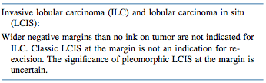

  Potential risk for residual DCIS – potential for re-excision if EIC present in young age and multiple close margins. May be a role for post-operative mammography to assess completeness of excision if calcifications.

Slide 25
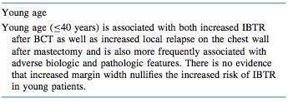
  Young women have higher IBTR and BC mortality then older women. This is due to tumour biology then type of surgery.
  Excision to negative margins, use of systemic therapy, use of radiation boost and possible exclusion of BRCA carriers from a BCS approach

Slide 26
  Conclusions:
  No ink on tumour as the standard for an adequate margin in invasive cancer in the era of multidisciplinary therapy is associated with low rates of IBTR and has potential to decrease re-excision rates, improve cosmetic results and decrease health care costs

Slide 27
Margins: simplified, maybe over simplified?
Inaccurate
Re-operation – not great
IBTR – margin width has minimal impact as long as not positive
Tumour biology and patient factors cannot be controlled by surgery

